Slide 1
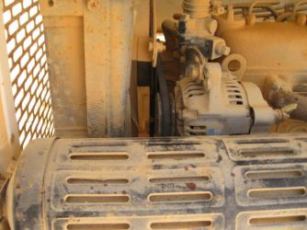
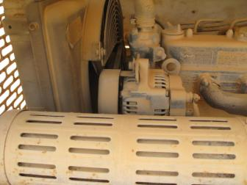
PDO Second Alert
Date: 09.07.19 Incident title: LTI
What happened?
At Rig 844 on the 9th of July 2018 at approximately 22:55hrs, a Roustabout and the Night Electrician were working on a tower light. Night Electrician tried to run the engine but it was not working. He went on the other side of the tower light to check the alternator while the roustabout tried to switch on the starter making the alternator rotate, causing the Night Electrician's left middle finger to be caught between the alternator pulley and belt, resulting in a injury to his left middle finger.
Your learning from this incident..
Always ensure pulley cover’s are installed
LOTO or PTW should always be used when working on energized equipment
Always ensure physical checks of PMs are taking place
Always ensure that guards are installed on equipment
Always isolate equipment before beginning maintenance tasks
Notes:
Ensure all dates and titles are input
A short description should be provided without mentioning names of contractors or individuals. You should include, what happened, to who (by job title) and what injuries this resulted in. Nothing more!
Four to five bullet points highlighting the main findings from the investigation. Remember the target audience is the front line staff so this should be written in simple terms in a way that everyone can understand.
The strap line should be the main point you want to get across
The images should be self explanatory, what went wrong (if you create a reconstruction please ensure you do not put people at risk) and below how it should be done.

Slide 2
Management self audit
Date: 09.07.19 Incident title: LTI
As a learning from this incident and to ensure continual improvement all contract managers must review their HSE HEMP against the questions asked below
Confirm the following:
Does your preventative maintenance check include checking guards and covers are installed?
Do you have a procedure to physically check/verify equipment PMs?
Do the Maintenance management team verify PMs are completed as per the required standard during site visits?
Does your maintenance team open a PTW before starting PM’s
* If the answer is NO to any of the above questions please ensure you take action to correct this finding.
Notes:
Ensure all dates and titles are input
Make a list of closed questions (only ‘yes’ or ‘no’ as an answer) to ask others if they have the same issues based on the management or HSE-MS failings or shortfalls identified in the investigation.
Imagine you have to audit other companies to see if they could have the same issues.
These questions should start with: Do you ensure…………………?

