Slide 1
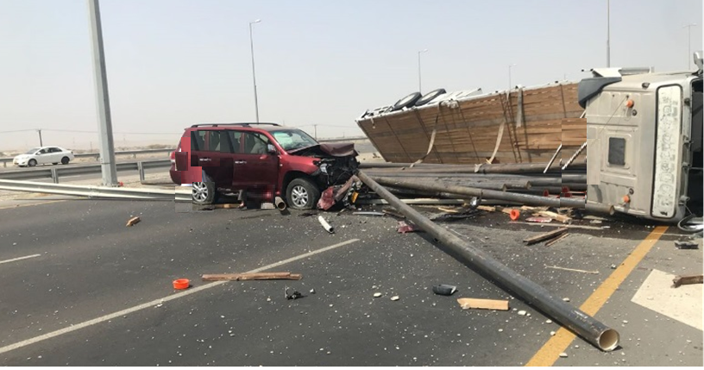
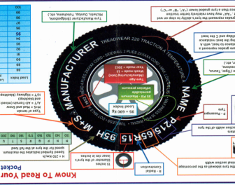
PDO Second Alert
Date: 02.07.2018 Incident title: LTI MVI
What happened?
Vehicle was travelling towards Muscat from Mussanah with a full load of pipes suffered a blow out to the front driver side tyre. The vehicle swerved to the left through both Armco barrier’s to the opposite side of the road before tipping on to the passenger side coming to rest across the carriageway. The load came off of the trailer, 19 of which remained on the highway and 23 of them went down the embankment before coming to a rest on the deserted ground at the bottom off the main highway. A 3rd party vehicle travelling on the opposite side of the carriageway has struck the pipes that were on the road and a second 3rd party vehicle has been reported to also have been involved.
Your learning from this incident..
Do you check your tyre conditions regularly
Do you ensure tyre pressures are correct and checked regularly
Do you ensure the tyre’s are in date (max 4 years)
Do you conduct daily vehicle inspection before starting your journey
Always ensure you check your vehicle and tyres before commencing journeys

Slide 2
Management self audit
Date: 02.07.2018 Incident title: LTI MVI
As a learning from this incident and to ensure continual improvement all contract managers must review their HSE HEMP against the questions asked below
Confirm the following:
Do you ensure drivers have been briefed to check their vehicle tyre conditions before journeys and during rest stops?
Do you have tyre inflation equipment and pressure gauges available for drivers to utilise?
Have you informed drivers / JM’s / vehicle inspectors on what to look for when checking tyres?
Do you have a procedure in place to conduct regular tyre pressure checks?
* If the answer is NO to any of the above questions please ensure you take action to correct this finding.
Notes:
Ensure all dates and titles are input
Make a list of closed questions (only ‘yes’ or ‘no’ as an answer) to ask others if they have the same issues based on the management or HSE-MS failings or shortfalls identified in the investigation.
Imagine you have to audit other companies to see if they could have the same issues.
These questions should start with: Do you ensure…………………?

