Slide 1
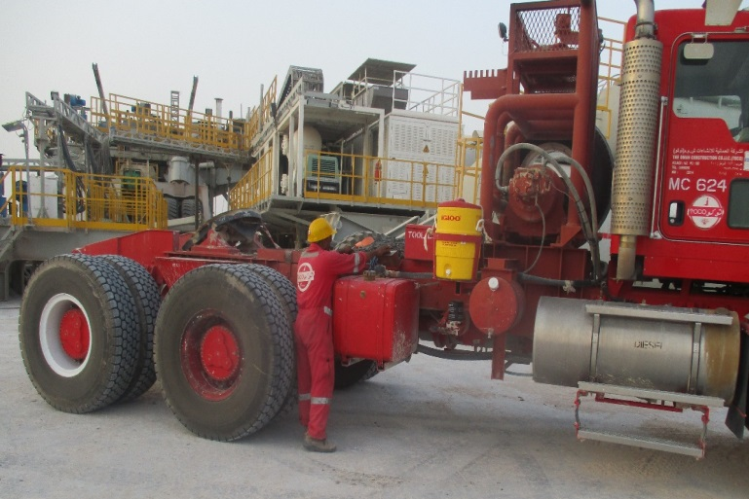
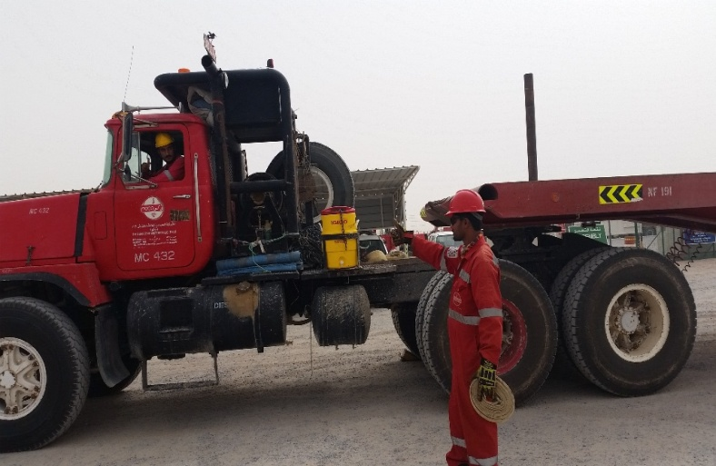
PDO Second Alert
Date: 20.07.2018 Incident Title: LTI
What happened?
On the 20/07/2018 at approximately 17:45 hours, a crew helper was placing the prime movers wheel chocks back into the storage bracket, located on the passenger side of the prime mover in front of and in close proximity to, the passenger side rear wheels, as the helper entered in to the gap between the 1st rear axle and the fuel tank the driver started moving his prime mover forward, resulting in the vehicle rear wheels striking the helper, causing him to fall to the ground and the vehicle wheels drove over the helpers legs.
Your learning from this incident..
Always ensure you keep yourself out of the line of fire.
Always ensure good lines of communications are maintained
Always ensure you’re the right person to undertake the activity
Always ensure you inform (verbally) the driver of the activity you are about to undertake
Always follow the procedures
Always ensure you wear hi visibility vest, to make sure everyone can see you
Ensure you see the driver and the driver see’s you before approaching the vehicle
SEE AND BE SEEN
Notes:
Ensure all dates and titles are input
A short description should be provided without mentioning names of contractors or individuals. You should include, what happened, to who (by job title) and what injuries this resulted in. Nothing more!
Four to five bullet points highlighting the main findings from the investigation. Remember the target audience is the front line staff so this should be written in simple terms in a way that everyone can understand.
The strap line should be the main point you want to get across
The images should be self explanatory, what went wrong (if you create a reconstruction please ensure you do not put people at risk) and below how it should be done.

Slide 2
Management self audit
Date: 20.07.2018 Incident Title: LTI
As a learning from this incident and to ensure continual improvement all contract managers must review their HSE HEMP against the questions asked below
Confirm the following:
Does your HEMP ensure the use of high visibility vests to be worn when in vehicle movement areas / areas where employees may be difficult to see?
Does your HEMP account for placement and removal of vehicle wheel chocks, by someone other than the driver?
Does your HEMP ensure the requirement for 2 way verbal communication to take place between the driver / operator of vehicles / equipment and anyone planning to interact with the vehicle / equipment?
Do you ensure Chocks are available for all heavy equipment?
* If the answer is NO to any of the above questions please ensure you take action to correct this finding.
Notes:
Ensure all dates and titles are input
Make a list of closed questions (only ‘yes’ or ‘no’ as an answer) to ask others if they have the same issues based on the management or HSE-MS failings or shortfalls identified in the investigation.
Imagine you have to audit other companies to see if they could have the same issues.
These questions should start with: Do you ensure…………………?

