Slide 1
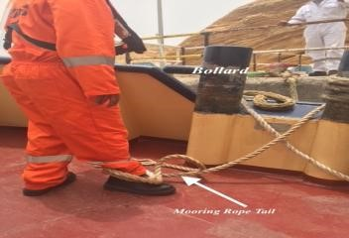
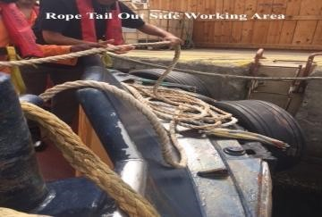
PDO Second Alert
Date: 21.07.2018 Incident title: LTI
What happened?
Able Seaman was working on the Tug Boat during an un-berthing of a tanker at Mina Al Fahal Port. He had assisted in securing the eye of the Port side mooring rope to a bollard and had placed 15 meters of 26 mm diameter tail rope on the forward deck. During the Tug’s maneuvers the eye of the mooring rope came off the bollard and as this rope was under tension it started to pull the tail rope into the water at high speed. The end of the tail rope struck his lower right leg and wrapped itself around his leg causing a fracture of the bones in this leg.
Your learning from this incident..
Always maintain clear communications between supervisor and able seamen.
Always keep clear of any rope under tension.
Always follow safe system of work.
Always place tail ropes behind barriers.
Keep clear of any rope under tension
Notes:
Ensure all dates and titles are input
A short description should be provided without mentioning names of contractors or individuals. You should include, what happened, to who (by job title) and what injuries this resulted in. Nothing more!
Four to five bullet points highlighting the main findings from the investigation. Remember the target audience is the front line staff so this should be written in simple terms in a way that everyone can understand.
The strap line should be the main point you want to get across
The images should be self explanatory, what went wrong (if you create a reconstruction please ensure you do not put people at risk) and below how it should be done.

Slide 2
Management self audit
Date: 21.07.2018 Incident title: LTI
As a learning from this incident and ensure continual improvement all contract
managers must review their HSE HEMP against the questions asked below
Confirm the following:
Do you ensure all communications are clear and understood by all parties.
Do you ensure all persons are clear any rope under tension and these ropes are identified in the HEMP.
Do you ensure regular assessment of staff competencies.
Do you ensure equipment is being used correctly.
Do you conduct site visits during live operations.
* If the answer is NO to any of the above questions please ensure you take action to correct this finding.
Notes:
Ensure all dates and titles are input
Make a list of closed questions (only ‘yes’ or ‘no’ as an answer) to ask others if they have the same issues based on the management or HSE-MS failings or shortfalls identified in the investigation.
Imagine you have to audit other companies to see if they could have the same issues.
These questions should start with: Do you ensure…………………?

