Slide 1
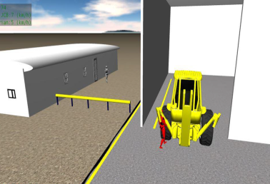
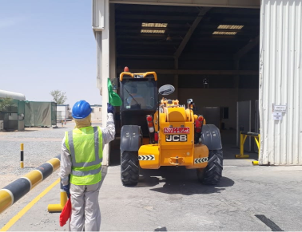
PDO Second Alert
Date:24.7.2018 Incident Type: Fatality
What happened?
On 24th July 2018 at approximately 16:43Hrs, the Plant Store in charge was walking past the entrance to the workshop when he was struck by a reversing Telehandler. It is believed that he was struck by the body of the counterbalance before being knocked to the ground, falling under the reversing wheel of the vehicle and run over causing a serious injures to his left leg.
Your learning from this incident..
Always ensure you use a banksman
Always intervene and report any unsafe act / condition / Near miss to your immediate supervisor.
Always ensure you check for moving plant/machinery
Always be watchful to your surroundings
Always use a banksman with reversing
Notes:
Ensure all dates and titles are input
A short description should be provided without mentioning names of contractors or individuals. You should include, what happened, to who (by job title) and what injuries this resulted in. Nothing more!
Four to five bullet points highlighting the main findings from the investigation. Remember the target audience is the front line staff so this should be written in simple terms in a way that everyone can understand.
The strap line should be the main point you want to get across
The images should be self explanatory, what went wrong (if you create a reconstruction please ensure you do not put people at risk) and below how it should be done.

