Slide 1
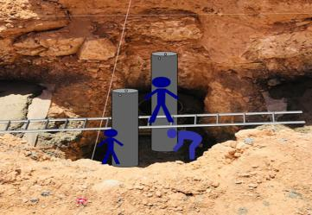
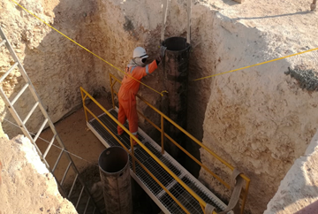
PDO Second Alert
Date: 13.09.2018 Incident title: LTI
What happened?
Cellar crew while aligning the mousehole pipe manually in the pit, one of the crew member was standing on an unstable platform (ladder used as working platform) holding the pipe which was placed on wet PCC. While aligning the pipe, it tilted and fell down near the mason who was wedging the pipe. The left leg of mason got entrapped between the pipe and cellar wall resulting in fracture to his tibia bone.
Your learning from this incident..
Make sure that the crew is well aware about the procedure and a well defined procedure is in place.
Use the right tools and equipment for the job.
Lifting belt should not be removed from the pipe until proper support provided for the pipe.
Always stand away from line of fire.
Provide proper working platform for the activity.
Carryout a DRR when there is a change in planned activity and address the additional hazards prior to start the work.
• Conduct a TBT for workers to communicate the change in work plan and ensure controls are in place.
Always intervene an unsafe act
Pre-fabricated fixture for installing mousehole pipe
Notes:
Ensure all dates and titles are input
A short description should be provided without mentioning names of contractors or individuals. You should include, what happened, to who (by job title) and what injuries this resulted in. Nothing more!
Four to five bullet points highlighting the main findings from the investigation. Remember the target audience is the front line staff so this should be written in simple terms in a way that everyone can understand.
The strap line should be the main point you want to get across
The images should be self explanatory, what went wrong (if you create a reconstruction please ensure you do not put people at risk) and below how it should be done.

Slide 2
Management self audit
Date: 13.09.2018 Incident title: LTI
As a learning from this incident and to ensure continual improvement all contract
managers must review their HSE HEMP against the questions asked below
Confirm the following:
Do you ensure you follow the procedures?
Do you ensure you identify all hazards before commencing the activity?
Do you ensure you are in a safe position while performing manual tasks?
Do you ensure that learnings from incidents is implemented effectively and its effectiveness monitored?
Do you ensure you have suitable and adequate work procedures in place for safe execution of task?
Do you ensure timely revision of safe work procedures?
If the answer is NO to any of the above questions please ensure you take action to correct this finding.
Notes:
Ensure all dates and titles are input
Make a list of closed questions (only ‘yes’ or ‘no’ as an answer) to ask others if they have the same issues based on the management or HSE-MS failings or shortfalls identified in the investigation.
Imagine you have to audit other companies to see if they could have the same issues.
These questions should start with: Do you ensure…………………?

