Slide 1
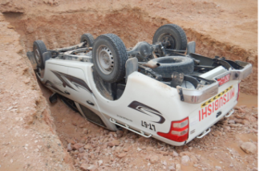
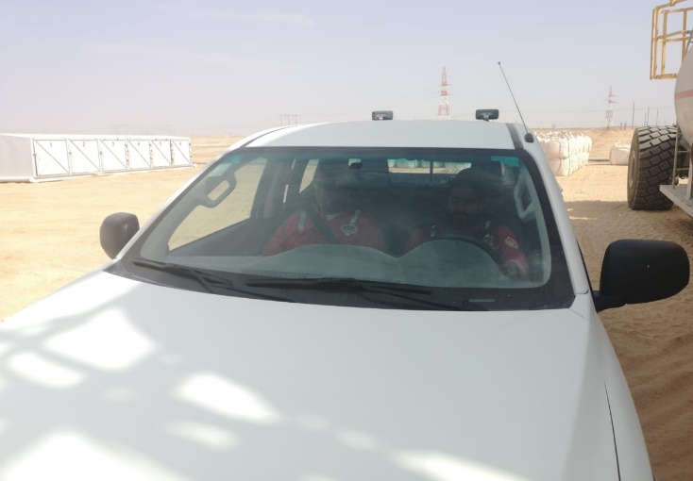
PDO Second Alert
Date: 29.07.2018 Incident title: HiPo MVI
What happened?
At approximately 3:50 am early morning , a Floor man (Driver) was driving from the main camp toward the rig site. 500 meters from the rig location, the vehicle drifted off the graded road and tipped over inside an unmarked pipeline excavation on side of the graded road..
Your learning from this incident..
Always ensure you have adequate rest
Always ensure you are authorised for the task
Ensure to return vehicle keys after use to the key control clocker
Ensure to report road hazards to the journey manager.
"Fatigue Kills”
Notes:
Ensure all dates and titles are input
A short description should be provided without mentioning names of contractors or individuals. You should include, what happened, to who (by job title) and what injuries this resulted in. Nothing more!
Four to five bullet points highlighting the main findings from the investigation. Remember the target audience is the front line staff so this should be written in simple terms in a way that everyone can understand.
The strap line should be the main point you want to get across
The images should be self explanatory, what went wrong (if you create a reconstruction please ensure you do not put people at risk) and below how it should be done.

Slide 2
Management self audit
Date: 29.07.2018 Incident title: HiPo MVI
As a learning from this incident and to ensure continual improvement all contract managers must review their HSE HEMP against the questions asked below
Confirm the following:
Do you manage / control night trips between camp & rig?
Do you ensure adequate rest before trips to avoid fatigue?
Do you ensure safety controls measures on any road construction?
Do ensure reported road hazards & risks are being followed up?
* If the answer is NO to any of the above questions please ensure you take action to correct this finding.
Notes:
Ensure all dates and titles are input
Make a list of closed questions (only ‘yes’ or ‘no’ as an answer) to ask others if they have the same issues based on the management or HSE-MS failings or shortfalls identified in the investigation.
Imagine you have to audit other companies to see if they could have the same issues.
These questions should start with: Do you ensure…………………?

