Slide 1
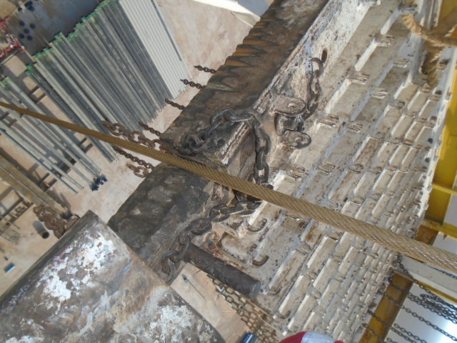
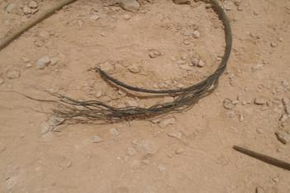
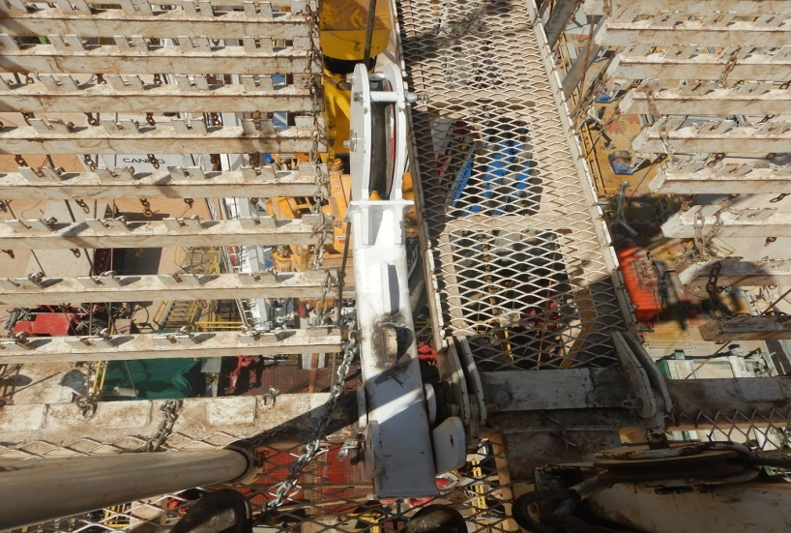
PDO Second Alert
Date: 04.08.2018 Incident title: HiPo
What happened?
At approximately 10:00 am on 4th of August, Drilling top hole (12.25” ) was in progress. and crew members started picking the third Drill Collar from the catwalk for placing it in to the mouse hole by using the Rig winch (5T). When the Drill collar was half way in to the mouse hole, the winch line got parted resulting the drill collar to drop in side the mouse hole approximately 4 meters along with the parted winch line on the rig floor.
There was no personal injury.
Your learning from this incident..
Ensure guide arm / similar arrangement is provided to prevent winch lines rubbing on any equipment.
Keep clear from the mouse hole area once the pipe is guided in.
Always watch the winch line when the load is being attached.
Always perform inspection on the lifting equipment, during 6 monthly inspection even if it new.
Always ensure lifting gears inspected before use.
Always ensure all winch lines are included in the lifting register and third party inspection is valid.
Winch line rubbing in monkey-board fingers
Winch line guide arm
Ensure guide arm / similar arrangement is provided to prevent winch lines rubbing on any equipment.
Winch line guide arm
Notes:
Ensure all dates and titles are input
A short description should be provided without mentioning names of contractors or individuals. You should include, what happened, to who (by job title) and what injuries this resulted in. Nothing more!
Four to five bullet points highlighting the main findings from the investigation. Remember the target audience is the front line staff so this should be written in simple terms in a way that everyone can understand.
The strap line should be the main point you want to get across
The images should be self explanatory, what went wrong (if you create a reconstruction please ensure you do not put people at risk) and below how it should be done.

Slide 2
Management self audit
Date: 04.08.2018 Incident title: HiPo
As a learning from this incident and to ensure continual improvement all contract managers must review their HSE HEMP against the questions asked below
Confirm the following:
Do you ensure the necessary arrangements are done to prevent winch line entanglements?
Do you ensure the learning from incidents related to engineering control are implemented?
Do you ensure the quality of the HSE inspections / Audits?
Do you ensure site leaders competency on critical aspects?
* If the answer is NO to any of the above questions please ensure you take action to correct this finding.
Notes:
Ensure all dates and titles are input
Make a list of closed questions (only ‘yes’ or ‘no’ as an answer) to ask others if they have the same issues based on the management or HSE-MS failings or shortfalls identified in the investigation.
Imagine you have to audit other companies to see if they could have the same issues.
These questions should start with: Do you ensure…………………?

