Slide 1
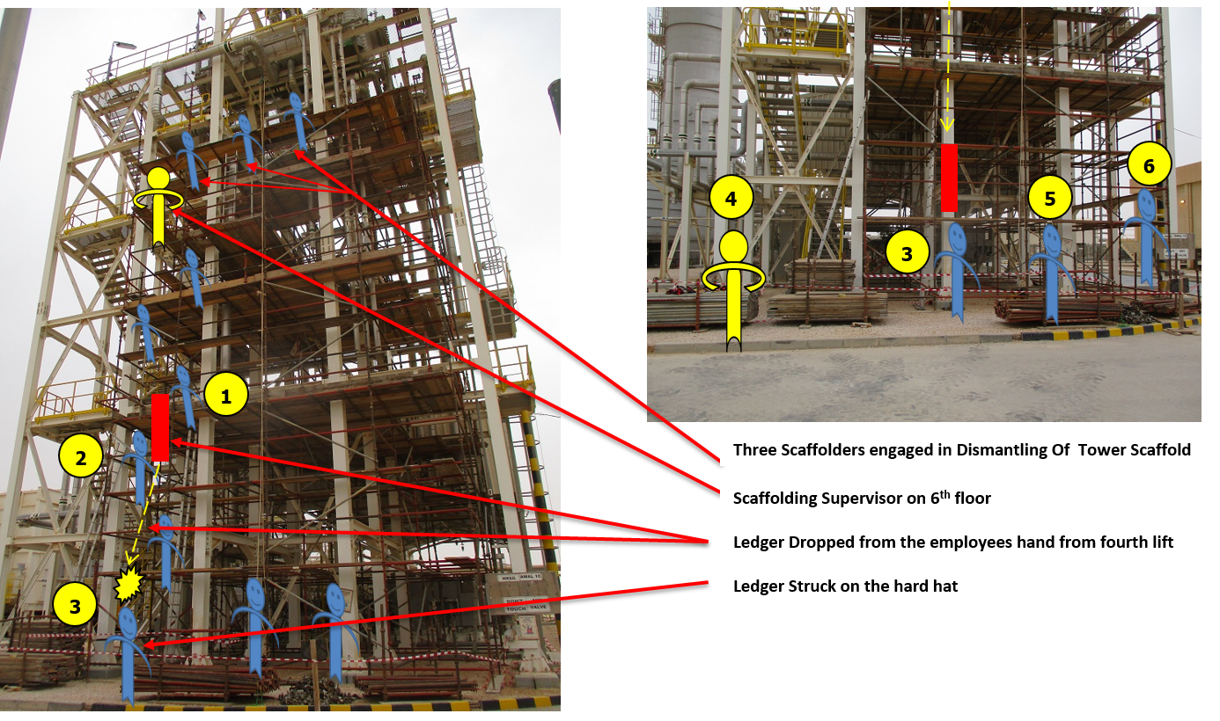
PDO Second Alert
Date: 12.08.2018 Incident title: HiPo
What happened?
On 12th August 18 at around 0815 hrs, during the removal and shifting of the ledgers at 4th level platform, a worker released his hold on a ledger without waiting for the worker on the 3rd level platform to receive it. The ledger fell and hit on the helmet of the Helper who was working on the ground level. The impact resulted in mild swelling and pain on his forehead.
Your learning from this incident..
Do you consider “line of fire” and ‘drops risks’ before attempting any work at height tasks?
Do you ensure effective communication measures are practiced for activities involving man chain?
Do you ensure that such activities are effectively supervised by the competent supervisor?
Do you ensure emergency procedure followed at time of the incident ?
Effective communication prevents incidents
Notes:
Ensure all dates and titles are input
A short description should be provided without mentioning names of contractors or individuals. You should include, what happened, to who (by job title) and what injuries this resulted in. Nothing more!
Four to five bullet points highlighting the main findings from the investigation. Remember the target audience is the front line staff so this should be written in simple terms in a way that everyone can understand.
The strap line should be the main point you want to get across
The images should be self explanatory, what went wrong (if you create a reconstruction please ensure you do not put people at risk) and below how it should be done.

Slide 2
Management self audit
Date: 12.08.2018 Incident title: HiPo
As a learning from this incident and to ensure continual improvement all contract
managers must review their HSE HEMP against the questions asked below
Confirm the following:
Do you have a system of review the job and reduce manual handling?
Do you ensure that proper mode of communication is maintained while performing the task?
Do we have a system of addressing the workplace risks when normal control measures are not feasible due to any site specific constraints?
Do you ensure effective supervision and close monitoring is carried out while performing the task?
Are all scaffolders trained in hand balling method ?
Do you conduct a effective emergency drill incase of incidents where suppose to report ?
Notes:
Make a list of closed questions (only ‘yes’ or ‘no’ as an answer) to ask other contractors if they have the same issues based on the management or HSE-MS failings or shortfalls identified in the investigation. Pretend you have to audit other companies to see if they could have the same issues.

