Slide 1
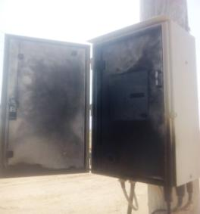
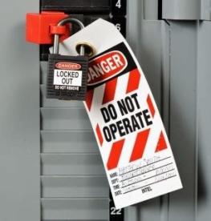
PDO Second Alert
Date: 09.09.2018 Incident title: HiPo
What happened?
An electrical crew were applying additional earthing when a flashover occurred in PMR panel causing skin burn to a helper who was standing approx. 1m from the panel.
Your learning from this incident..
Always ensure isolation is verified prior to applying additional earthing.
Always ensure a switching program is created using correct, up-to-date drawings.
Always ensure that a correct line is isolated prior to starting the job.
Always ensure a PTW Holder gives instructions to the ground staff to stay. clear of the PMR panel until isolation is confirmed.
Always verify isolation before starting any electrical job!
Notes:
Ensure all dates and titles are input
A short description should be provided without mentioning names of contractors or individuals. You should include, what happened, to who (by job title) and what injuries this resulted in. Nothing more!
Four to five bullet points highlighting the main findings from the investigation. Remember the target audience is the front line staff so this should be written in simple terms in a way that everyone can understand.
The strap line should be the main point you want to get across
The images should be self explanatory, what went wrong (if you create a reconstruction please ensure you do not put people at risk) and below how it should be done.

Slide 2
Management self audit
Date: 09.09.2018 Incident title: HiPo
As a learning from this incident and to ensure continual improvement all contract managers must review their HSE HEMP against the questions asked below
Confirm the following:
Do you ensure your CEPs and AEPs follow PDO safe electrical rules as outlined in PR1947 and PR1948?
Do you ensure your PTW Holders cross check their permits and feel empowered to question correct isolation?
Do you ensure your worksite supervisors are empowered to ignore phone calls from senior site staff when they are performing high risk activities?
Do you ensure your junior staff are well aware of all applicable hazards and observe required safety rules during electrical works?
Do you ensure that all electrical line diagrams are verified vis two AEPs?
* If the answer is NO to any of the above questions please ensure you take action to correct this finding.
Notes:
Ensure all dates and titles are input
Make a list of closed questions (only ‘yes’ or ‘no’ as an answer) to ask others if they have the same issues based on the management or HSE-MS failings or shortfalls identified in the investigation.
Imagine you have to audit other companies to see if they could have the same issues.
These questions should start with: Do you ensure…………………?

