Slide 1
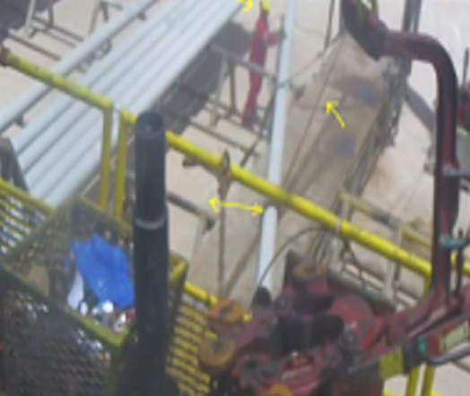
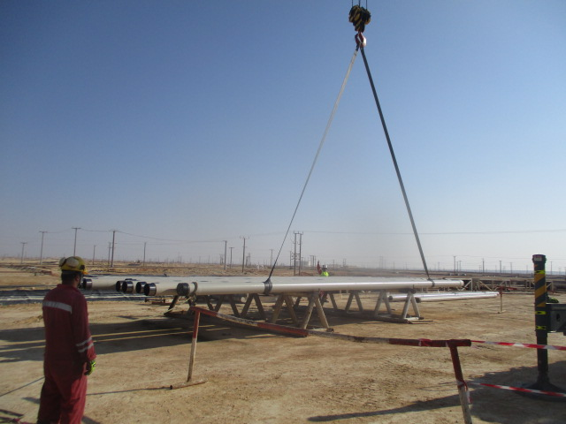
PDO Second Alert
Date: 14.09.2018 Incident title: HiPo
What happened?
During RIH 9 5/8” casing, Roustabout-2 wrapped the webbing sling on the casing joint from V door side to the casing which was rested on the two pipe racks. The Crane Operator moved the crane boom in order to give adequate slackness to the sling, for proper wrapping of the casing in the catwalk side. This move caused the casing to slide towards to the end of the catwalk.
Roustabout-1 was standing next to the landed point between catwalk & pipe rack.
Your learning from this incident..
Always ensure the crane operator is establishing signal communication with only one dedicated banksman for the lifting activities
Always intervene, if you observe any unsafe practice involved in the task.
Always ensure the boom is centered and the hook is lowered as low as possible before installing the sling.
Always implement and follow No go zone management protocol while working with crane near catwalk.
Always position the crane boom correctly before slinging the casing
Banksman
Always establish communication with the signalman to ensure safe practices at all time

Slide 2
Management self audit
Date: 14.09.2018 Incident title: HiPo
As a learning from this incident and to ensure continual improvement all contract
managers must review their HSE HEMP against the questions asked below
Confirm the following:
Do you ensure adequate controls while using the crane from learning values of past similar incidents ?
2. Do you use CCTV tool to monitor the behavior of an individual when required?
How you monitor the effectiveness of the intervention program?
Do you ensure staff use the audit to identify the behaviors while lifting operation / working with the crane ?
Do you ensure staff identify the hazards and risks related to lifting operation / working with the crane and capture in the TBT with TRIC?
Notes:
Make a list of closed questions (only ‘yes’ or ‘no’ as an answer) to ask other contractors if they have the same issues based on the management or HSE-MS failings or shortfalls identified in the investigation. Pretend you have to audit other companies to see if they could have the same issues.

