Slide 1
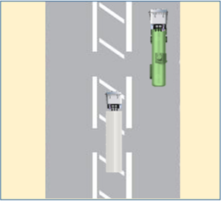


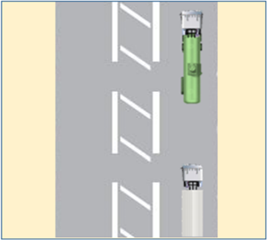


PDO Second Alert
Date: 18.09.2018 Incident title: HiPo MVI
What happened?
A heavy vehicle attempted to overtake a water tanker and in doing so crossed into the hatched area of the road, at the same time the water tanker attempted to cross the road also entering the hatched area to take an incorrect turn into a fuel station. At this point the heavy vehicle trailer struck the driver side area of the water tanker prime mover. This resulted in damage to the water tanker prime mover and luckily only minor injuries to the water tanker drivers hand.
Your learning from this incident…
Always follow your defensive driving training
Always ensure it is safe and legal before overtaking other vehicles
Always use your indicators (turn signal) before making maneuvers such as overtaking, turning at junctions and roundabouts, stopping at the side of the road and entering / exiting roads
Always ensure you follow your safe journey management plan
Ensure you report all incidents to your line manager
Always ensure you drive according to the road conditions
Only overtake when safe to do so

Slide 2
Management self audit
Date: 18.09.2018 Incident title: HiPo MVI
As a learning from this incident and to ensure continual improvement all contract
managers must review their HSE HEMP against the questions asked below
Confirm the following:
Do you conduct periodic competency assessments with your drivers?
Do you ensure your drivers are regularly briefed on following Road Safety Rules?
Do you ensure your drivers aware of the incident reporting procedures?
Do you conduct driver consequence management?
Do you review the IVMS data ensuring it is accurate and concise?
Do you ensure your vehicles are adhering to speed limits?
* If the answer is NO to any of the above questions please ensure you take action to correct this finding.
Notes:
Ensure all dates and titles are input
Make a list of closed questions (only ‘yes’ or ‘no’ as an answer) to ask others if they have the same issues based on the management or HSE-MS failings or shortfalls identified in the investigation.
Imagine you have to audit other companies to see if they could have the same issues.
These questions should start with: Do you ensure…………………?

