Slide 1
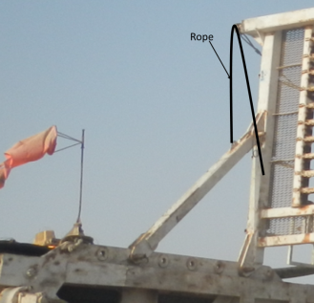
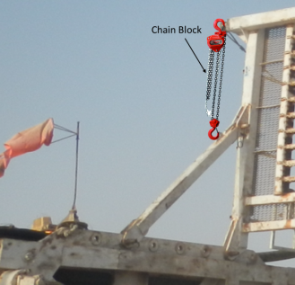
PDO Second Alert
Date: 21.09.2018 Incident type: HiPo DROPS
What happened?
Crane was used to support the monkey board, allowing removal of the supporting beams. While slacking the rope to lower the top side of the second supporting beam, the rope snapped causing the beam to fall on mast ladder cage and hit the top right corner of crane cabin.
There was no injury to personnel, but crane top glass was broken.
Your learning from this incident..
Always use fit for purpose lifting accessories.
Always ensure all DROP Zones are communicated & cleared to avoid Standing in Line of Fire.
Always ensure all potential DROPs objects have secondary retention and are recorded in the DROPs Register.
Ensure mast lowering checklist covers all steps related to monkey board.
Always use fit for purpose lifting accessories
Notes:
Ensure all dates and titles are input
A short description should be provided without mentioning names of contractors or individuals. You should include, what happened, to who (by job title) and what injuries this resulted in. Nothing more!
Four to five bullet points highlighting the main findings from the investigation. Remember the target audience is the front line staff so this should be written in simple terms in a way that everyone can understand.
The strap line should be the main point you want to get across
The images should be self explanatory, what went wrong (if you create a reconstruction please ensure you do not put people at risk) and below how it should be done.

Slide 2
Management self audit
Date: 21.09.18 Incident: Near Miss Hi-Po DROPS
As a learning from this incident and to ensure continual improvement all contract
managers must review their HSE HEMP against the questions asked below
Confirm the following:
Do you ensure DROPS Zones known and Controlled ?
Do you review all HEMPs and Procedure at least once a year?
Do you ensure all equipment removed from height have proper retention and lifting means ?
Do you ensure correct lifting accessories are used for the activity performed ?
Do you ensure that procedure provided and effectively communicated to all involved in the task?
Do you audit periodically audit rig move process?
* If the answer is NO to any of the above questions please ensure you take action to correct this finding.
Notes:
Ensure all dates and titles are input
Make a list of closed questions (only ‘yes’ or ‘no’ as an answer) to ask others if they have the same issues based on the management or HSE-MS failings or shortfalls identified in the investigation.
Imagine you have to audit other companies to see if they could have the same issues.
These questions should start with: Do you ensure…………………?

