Slide 1
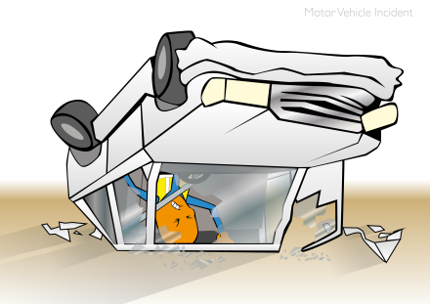
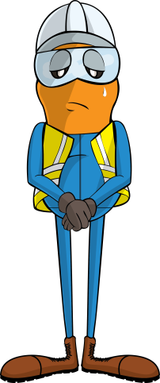
PDO Incident Road Safety Alert – (Private vehicles)
Incident type | Commuting (#01)
Date/ time | 20/03/2019 @21:20Hrs
Location | Lekhwair Area
What happened
The Derrickman left site in his private vehicle alone, while driving towards Fahud he crashed his car into the Lekhwair roundabout, rolling over multiple times before being thrown from the vehicle.
Sadly he has passed away, our thoughts and prayers are with the family of the deceased at this time.
Mr. Musleh asks the questions of can it happen to you?
Do you risk commuting by private vehicle?
Do you drive when it is dark?
Do you always wear your seatbelt?
Do you continue driving if you are fatigued?
Please disseminate this notification to your teams and use it in your tool box talks and HSE meetings and notice boards.

