Slide 1
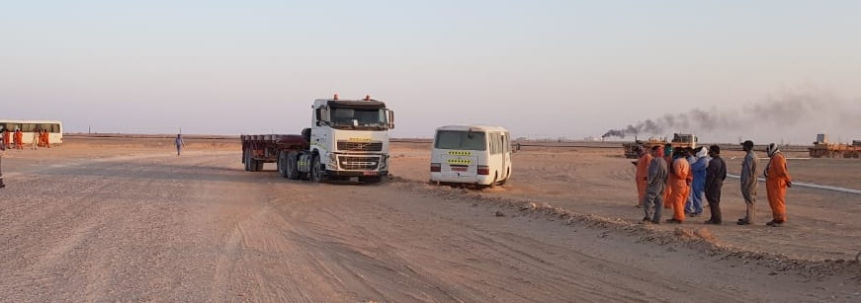
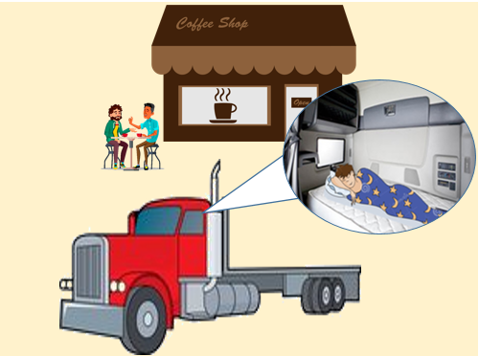
PDO Second Alert
Date: 02.10.2018 Incident title: HIPO MVI
What happened?
A Heavy Vehicle (prime mover and trailer) was travelling through a bend in a graded road when the driver fell asleep and veered onto the wrong side of the road where there was an oncoming Coaster bus which had 9 passengers on board. Both drivers had attempted to take evasive action, turning to their rights respectively, with the bus leaving the road onto the soft sand over a small windrow, however the HV struck the drivers side in the center of the Coaster bus resulting in minor damage to both vehicles.
There were no injuries sustained.
Your learning from this incident..
Always ensure you have enough rest before commencing duty
Always ensure you stop and inform your Journey Manager if you feel fatigued
Always ensure you take regular rest breaks
Always follow your prescribed Journey Plan timings
If you feel tired, STOP and take rest
Notes:
Ensure all dates and titles are input
A short description should be provided without mentioning names of contractors or individuals. You should include, what happened, to who (by job title) and what injuries this resulted in. Nothing more!
Four to five bullet points highlighting the main findings from the investigation. Remember the target audience is the front line staff so this should be written in simple terms in a way that everyone can understand.
The strap line should be the main point you want to get across
The images should be self explanatory, what went wrong (if you create a reconstruction please ensure you do not put people at risk) and below how it should be done.

Slide 2
Management self audit
Date: 02.10.2018 Incident title: HIPO MVI
As a learning from this incident and to ensure continual improvement all contract
managers must review their HSE HEMP against the questions asked below
Confirm the following:
Do you conduct regular training on fatigue management?
Do you ensure employees rest breaks provide sufficient time for meals and rest?
Do you ensure vehicles which you manage are being adequately tracked through IVMS?
Do you conduct sub contractor management audits?
Do you manage your vehicles when on free running rig move journeys?
Do you encourage the reporting of road hazards?
* If the answer is NO to any of the above questions please ensure you take action to correct this finding.
Notes:
Ensure all dates and titles are input
Make a list of closed questions (only ‘yes’ or ‘no’ as an answer) to ask others if they have the same issues based on the management or HSE-MS failings or shortfalls identified in the investigation.
Imagine you have to audit other companies to see if they could have the same issues.
These questions should start with: Do you ensure…………………?

