Slide 1
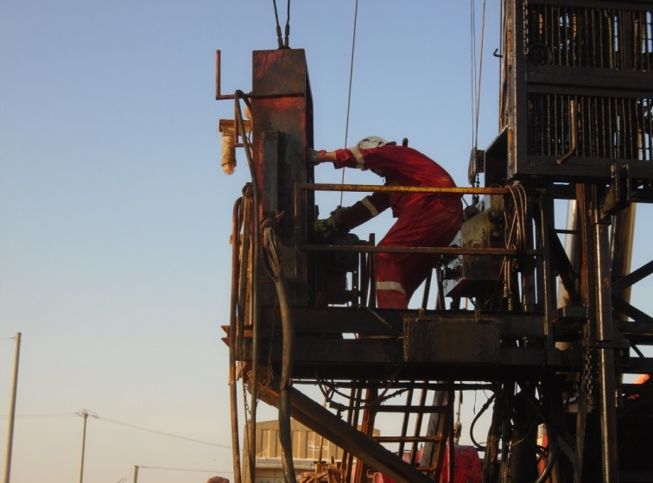
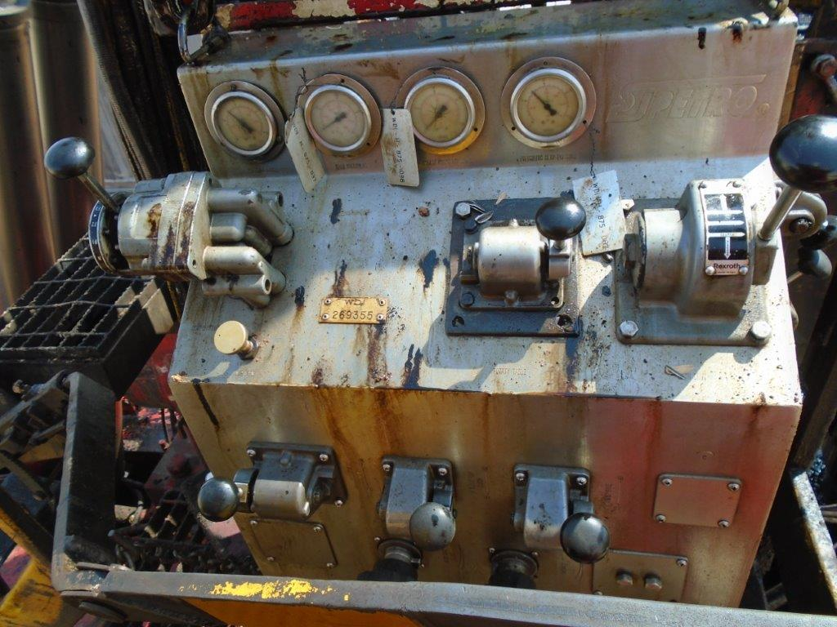
PDO Second Alert
Date: 20.10.2018 Incident title: HIPO
What happened?
At 00:40hrs on the 20 Oct 2018, The operation was Nipple up BOP in the
cellar and simultaneously the Driller was trying to setup the BOP Control panel
in place behind the drillers console.
At this time the travelling block started descending uncontrolled coming into
contact with the BOP (hit the oil tray on top of the annular) due to the hoist
floor not being installed yet.
The complete drilling line came out from Draw Works, all the way up passing
the first sheave. As soon the block landed on ground, the remaining drilling line
stayed on crown sheave.
Due to the slow descend of the travelling block there was no damage to the
equipment.
Your learning from this incident..
Always ensure a MOC is used when making changes to equipment setup
Always ensure locking mechanisms are available for secondary brake systems
Always ensure work areas aren't congested
Always ensure MOC is used when making changes to equipment setup
Notes:
Ensure all dates and titles are input
A short description should be provided without mentioning names of contractors or individuals. You should include, what happened, to who (by job title) and what injuries this resulted in. Nothing more!
Four to five bullet points highlighting the main findings from the investigation. Remember the target audience is the front line staff so this should be written in simple terms in a way that everyone can understand.
The strap line should be the main point you want to get across
The images should be self explanatory, what went wrong (if you create a reconstruction please ensure you do not put people at risk) and below how it should be done.

Slide 2
Management self audit
Date: 20.10.2018 Incident title: HIPO
As a learning from this incident and ensure continual improvement all contract
managers must review their HSE HEMP against the questions asked below
Confirm the following:
Do you ensure your staff have completed training on the use of your companies MOC system?
Do you ensure your drillers controls ergonomically correct?
Do you ensure a risk assessment has been completed on your units control stations or panels to ensure that are user friendly?
Do you ensure your secondary brakes have a locking system so that cant be accidently released?
Due you ensure all rig audit findings are communicated to senior management before actions are put in place?
* If the answer is NO to any of the above questions please ensure you take action to correct this finding.
Notes:
Ensure all dates and titles are input
Make a list of closed questions (only ‘yes’ or ‘no’ as an answer) to ask others if they have the same issues based on the management or HSE-MS failings or shortfalls identified in the investigation.
Imagine you have to audit other companies to see if they could have the same issues.
These questions should start with: Do you ensure…………………?

