Slide 1
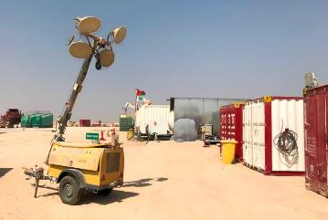
PDO Second Alert
Date: 20.10.2018 Incident: HiPo
What happened?
While rigging down the tower light in the process of lowering down the light pole, the hoist gear got stuck. The operator called the mechanic to inspect the issue and he came and assess and could not rectify the issue therefore the mechanic went to his shop to look for barricade tape, LOTO gears in order to isolate the work area. During this time, the mechanic heard a loud bang. He then came out of the shop and noticed one employee (IP) laid down on the ground and noticed an injury on his head.
Learnings:
Always ensure no equipment to be left unattended during any repair/maintenance.
Constantly ensure clear communication of all safety zones would not be functional during mobilization and demobilization.
All the time during mobilization/demobilization it is mandatory to wear full PPE.
Use JSA’s for any task.
Ensure work area is secure and LOTO applied before start any repair work
Notes:
Ensure all dates and titles are input
A short description should be provided without mentioning names of contractors or individuals. You should include, what happened, to who (by job title) and what injuries this resulted in. Nothing more!
Four to five bullet points highlighting the main findings from the investigation. Remember the target audience is the front line staff so this should be written in simple terms in a way that everyone can understand.
The strap line should be the main point you want to get across
The images should be self explanatory, what went wrong (if you create a reconstruction please ensure you do not put people at risk) and below how it should be done.

Slide 2
Management self audit
Date: 20.10.2018 Incident: HiPo
As a learning from this incident and ensure continual improvement all contract
managers must review their HSE HEMP against the questions asked below
Confirm the following:
Does your maintenance program cover all components on equipment (Light Tower)?
Do you enforce consequence management for HSE violations?
Has the HEMP risk assessment been properly rolled out and understood by the employees in your organization ?
Have you refreshed your employees in the change management usage?
Are you verifying that your management team is active in the HSE audit process?
* If the answer is NO to any of the above questions please ensure you take action to correct this finding.
Notes:
Ensure all dates and titles are input
Make a list of closed questions (only ‘yes’ or ‘no’ as an answer) to ask others if they have the same issues based on the management or HSE-MS failings or shortfalls identified in the investigation.
Imagine you have to audit other companies to see if they could have the same issues.
These questions should start with: Do you ensure…………………?

