Slide 1
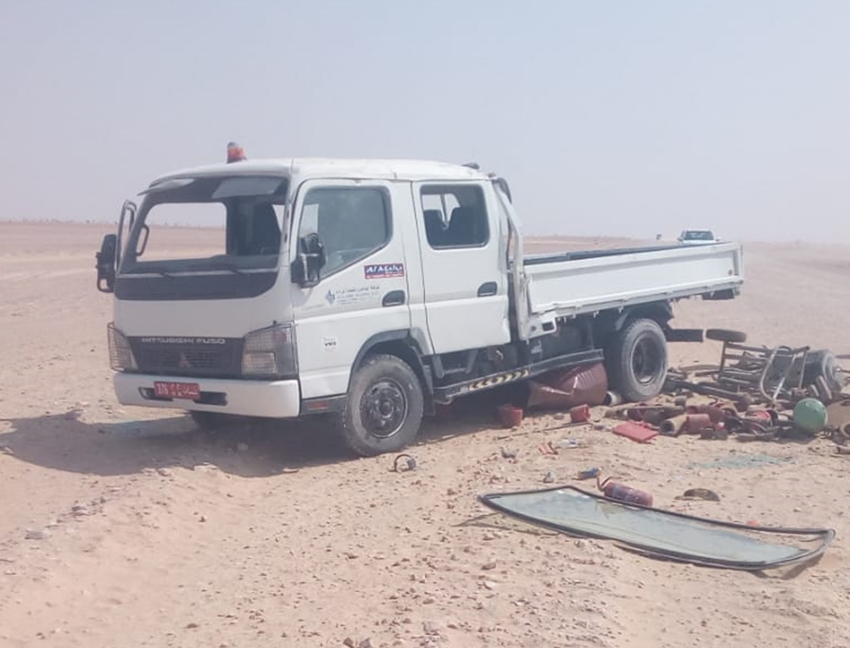
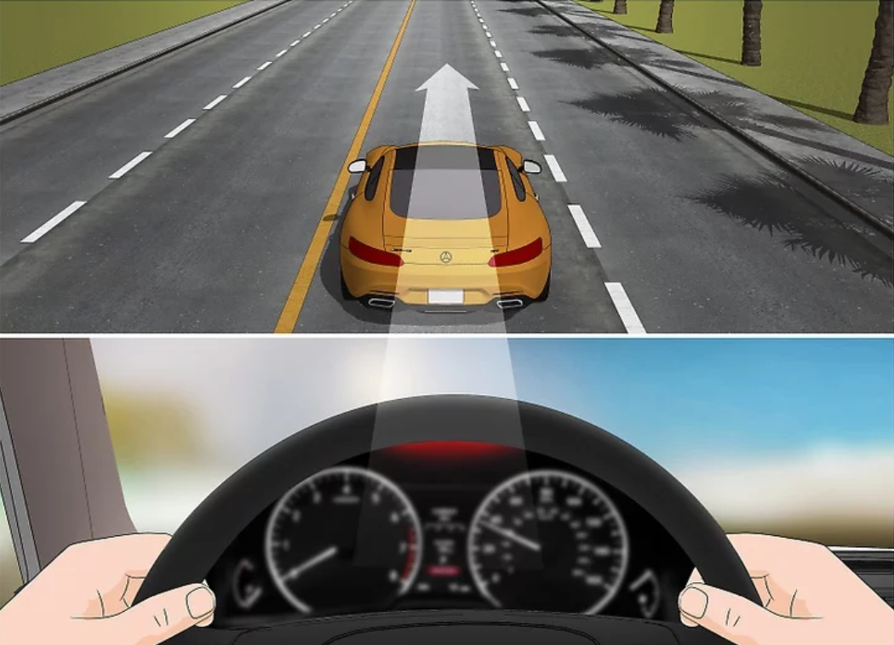
PDO Second Alert
Date: 31.10.2018 Incident type: HiPo
What happened?
Two personnel start a trip from location TD-04 (HWO-2) heading to Adam base with a rental Canter through PDO concession area graded road. While they were on the road about 40km before Saih Rawl, the Canter encountered a punched tire (front passenger side) causing the driver to lose control over the vehicle resulting to rollover.
No injuries / illness was encountered to the vehicle occupants.
Your learning from this incident…
Always hold the steering wheel straight and release the accelerator till vehicle is fully stopped if the vehicle tire punctures while driving .
Always follow Journey management process
Always use Stop Work Rules (Intervention)
Do Not Start Any journey without proper driving training.
Notes:
Ensure all dates and titles are input
A short description should be provided without mentioning names of contractors or individuals. You should include, what happened, to who (by job title) and what injuries this resulted in. Nothing more!
Four to five bullet points highlighting the main findings from the investigation. Remember the target audience is the front line staff so this should be written in simple terms in a way that everyone can understand.
The strap line should be the main point you want to get across
The images should be self explanatory, what went wrong (if you create a reconstruction please ensure you do not put people at risk) and below how it should be done.

Slide 2
Management Self Audit
Date: 31.10.2018 Incident type: HiPo
As a learning from this incident and ensure continual improvement all contract
managers must review their HSE HEMP against the questions asked below
Confirm the following:
Do you ensure that your journey management process is capturing any gaps within the training?
Do you ensure that your assurance process is capturing any gaps in the Journey Management?
Do you ensure that local requirements are properly communicated and understood by all involved parties?
Do you ensure that lesson learnt are shared and best practices are implemented?
Do you ensure that the tires are included in the preventive maintenance program?
* If the answer is NO to any of the above questions please ensure you take action to correct this finding.
Notes:
Ensure all dates and titles are input
Make a list of closed questions (only ‘yes’ or ‘no’ as an answer) to ask others if they have the same issues based on the management or HSE-MS failings or shortfalls identified in the investigation.
Imagine you have to audit other companies to see if they could have the same issues.
These questions should start with: Do you ensure…………………?

