Slide 1
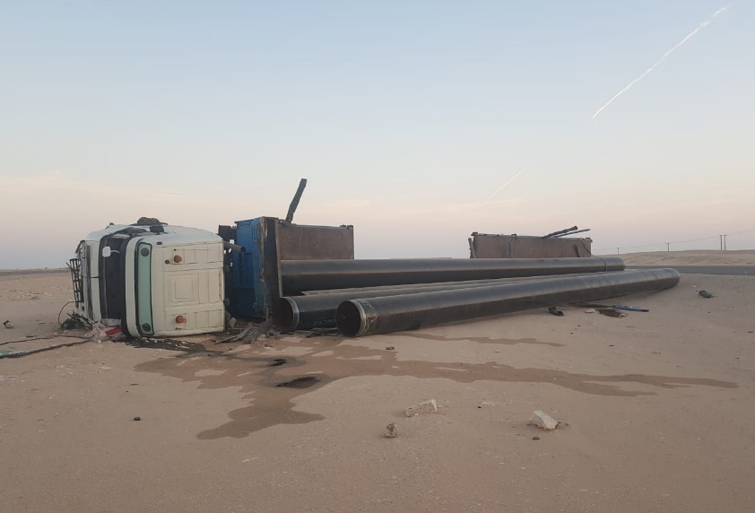
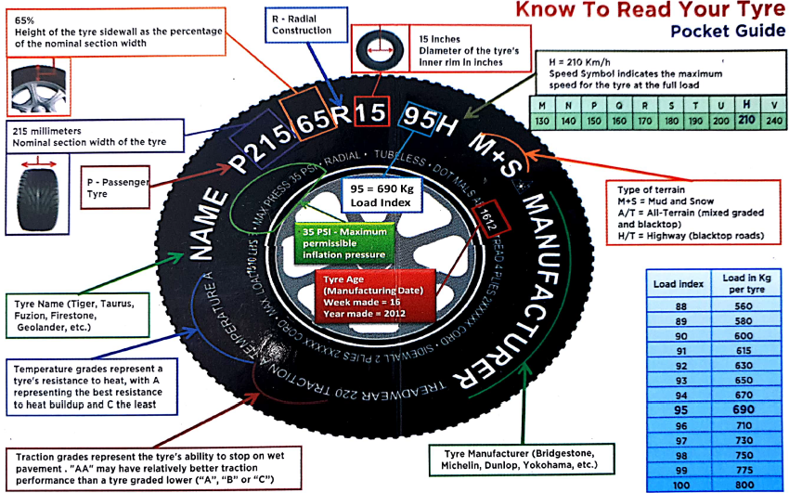
PDO Second Alert
Date: 29.11.2018 Incident title: HiPo
What happened?
Vehicle was travelling towards Nimr from Haima with a load of line pipes was involved in an MVI. Whilst travelling on the Haima – Salalah road approximately 2km from the Nimr T-Junction the vehicle suffered a blow out to the front passenger side tyre. The vehicle swerved to the right leaving the road, where the passenger side wheels struck a raised rock area before tipping on to the driver side coming to rest at the side of the road. The load securing belts snapped allowing the pipes to roll off the trailer.
Your learning from this incident…
Do you ensure you check your tyre conditions regularly
Do you ensure tyre pressures are correct and checked regularly
Do you ensure the tyre’s are in date (max 4 years)
Do you conduct daily vehicle inspection before starting your journey
Always ensure you check your vehicle and tyres before commencing journeys

Slide 2
Management self audit
Date: 29.11.2018 Incident title: HiPo
As a learning from this incident and ensure continual improvement all contract
managers must review their HSE HEMP against the questions asked below
Confirm the following:
Do you ensure drivers have been briefed to check their vehicle tyre conditions before journeys and during rest stops?
Do you have tyre inflation equipment and pressure gauges available for drivers to utilise?
Have you informed drivers / JM’s / vehicle inspectors on what to look for when checking tyres?
Do you have a procedure in place to conduct regular tyre pressure checks?
Do you have procedures in place to ensure vehicle tyres are replaced before they reach 4 years old?
Do you record the age of vehicle tyres?
* If the answer is NO to any of the above questions please ensure you take action to correct this finding.
Notes:
Ensure all dates and titles are input
Make a list of closed questions (only ‘yes’ or ‘no’ as an answer) to ask others if they have the same issues based on the management or HSE-MS failings or shortfalls identified in the investigation.
Imagine you have to audit other companies to see if they could have the same issues.
These questions should start with: Do you ensure…………………?

