Slide 1
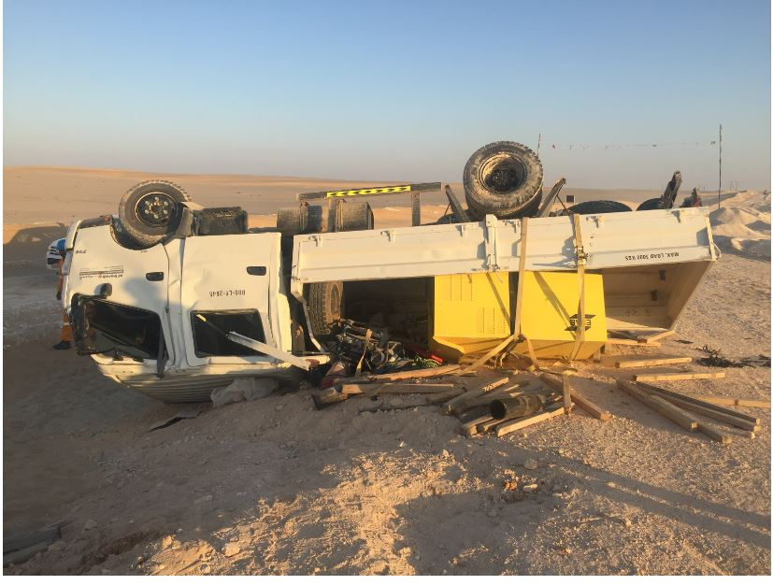
PDO Second Alert
Date: 29.11.2018 Incident title: HiPo #46 – MVI
What happened?
On 29.11.18 the crew consisting of 5 employees and the driver were travelling back to Bahja camp from Zualiyah. Around 03:25 pm, vehicle was travelling on the diversion graded road, the right tyres (front and rear) of the vehicle ran over a wet and slippery patch on the road. The driver lost the control of the vehicle and rolled over towards the left side of the road.
Your learning from this incident..
Always drive very slowly while driving over wet and slippery patches on road.
Always follow defensive driving techniques.
Always wear seat belt
Photo explaining what was done wrong
Drive as per the road condition

Slide 2
Management self audit
Date: 29.11.2018 Incident title: HiPo # 46 MVI
As a learning from this incident and to ensure continual improvement all contract managers must review their HSE HEMP against the questions asked below
Confirm the following:
Do you ensure that the drivers are driving as per the road condition
Do you ensure that Journey Management system is audited
Do you ensure actions from Learning from Incidents are effectively cascaded and implemented.
Do you ensure compliance to the identified speed limits while driving.
* If the answer is NO to any of the above questions please ensure you take action to correct this finding.
Notes:
Ensure all dates and titles are input
Make a list of closed questions (only ‘yes’ or ‘no’ as an answer) to ask others if they have the same issues based on the management or HSE-MS failings or shortfalls identified in the investigation.
Imagine you have to audit other companies to see if they could have the same issues.
These questions should start with: Do you ensure…………………?

