Slide 1
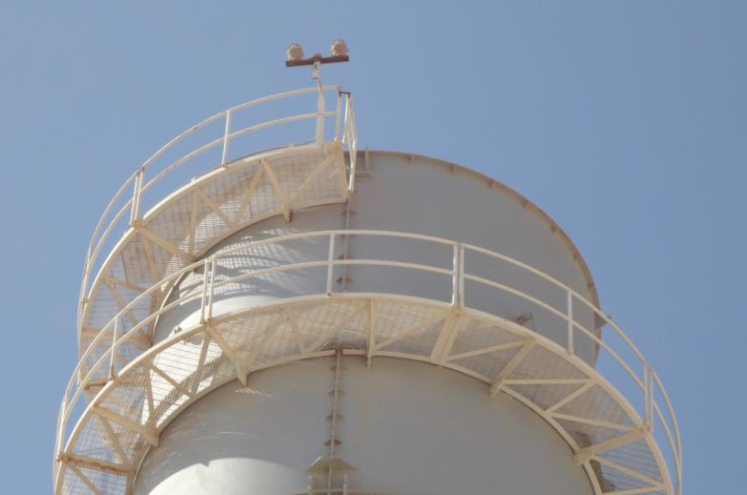
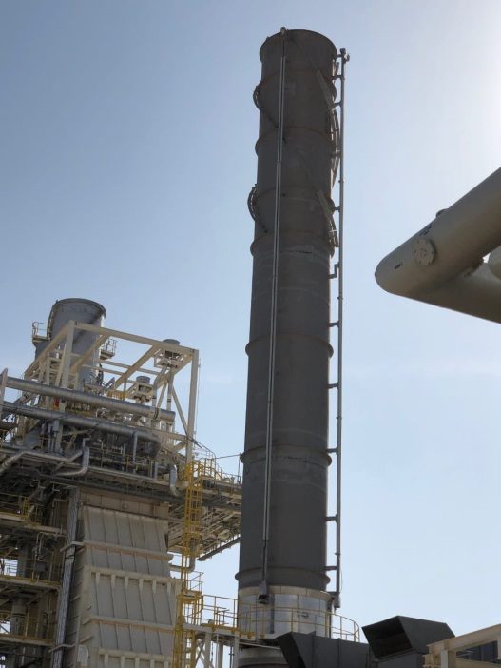
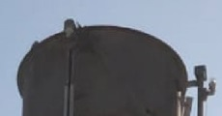
PDO Second Alert
Date: 29.11.2018 Incident type: HiPo
Both lights are bolted on single support
What happened?
Aviation warning light assembly with its support (weight-approx. 9 kg) installed at the top of G6602 Gas Turbine. Exhaust stack in Mukhaizna Power Station has fallen down from 35.744 meter.
Your learning from this incident..
Always perform a periodic inspection/monitoring for GT exhaust stack /light assembly.
Select the materials which is appropriate for the environmental conditions.
Stack with lightings in different design; movable aviation lightings from top to bottom with a rail operating mechanism
Establish, maintain and monitor the maintenance plan always
Aviation warning lights

Slide 2
Management actions
Date: 29.11.2018 Incident type: HiPo
As a learning from this incident and ensure continual improvement all contract
managers are to review their HSE HEMP against the questions asked below
Confirm the following:
Do you ensure inspection and maintenance are covering the operations in remote area?
Do you ensure the environment factors are considered during the design phase with regards to metal fixtures and fittings ?
Do you ensure the corrosion issues are reported on time?
Do you review the design specification and requirement regularly?

