Slide 1
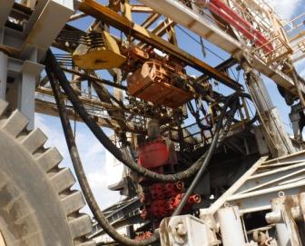
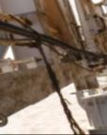
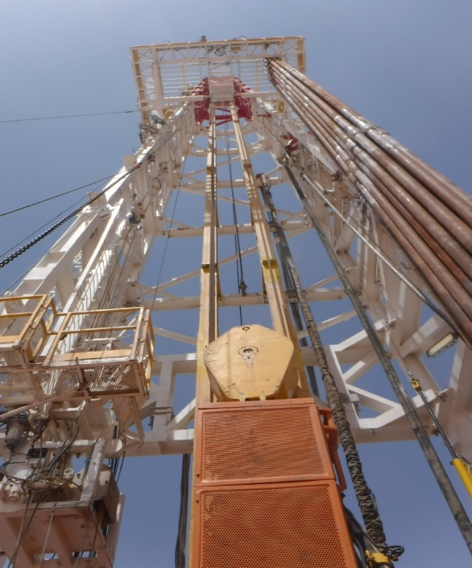
PDO Second Alert
Date: 15.10.2018 Incident type: LTI
What happened?
While preparing the mast dolly , derrick man was cleaning pin in order to attach the dolly to the mast.
When the securing ropes of the rotary hose broke resulting in rotary hose swinging and pushing the derrick man forward, trapping his leg between two beams causing fracture in his right leg thigh bone.
Your learning from this incident..
Always use correct securing method for securing the rotary hose. (web sling)
Always ensure safe body position and clear off line of fire.
Always do drops inspection after mast lowering
Always prepare the mast dolly prior to lowering the mast.
Use of MEWP (Cherry picker) when ever applicable.
Always use safety harness and attach lanyard adequately while working at height.
Rotary hose and service loop secured with Rope
Rotary hose and service loop Securing points
Never use manila rope for securing suspended load

Slide 2
Date: 15/10/2018 Incident type: LTI
As a learning from this incident and to ensure continual improvement all contract
managers must review their HSE HEMP against the questions asked below
Confirm the following:
Do you ensure proper securing methods used for securing the rotary hose and service loop prior lowering the mast? Is there a procedure? Do they ensure it is followed company wide?
Do you ensure that area is safe for working before starting the job?
Do you ensure that risk assessment is carried out prior the job and the task is clear to the crew members?
Do your ensure supervisors plan the job and identify the associated risks before starting the job?
Do you ensure that your units correctly secure rotary hose and equipment in mast.
Notes:
Ensure all dates and titles are input
Make a list of closed questions (only ‘yes’ or ‘no’ as an answer) to ask others if they have the same issues based on the management or HSE-MS failings or shortfalls identified in the investigation.
Imagine you have to audit other companies to see if they could have the same issues.
These questions should start with: Do you ensure…………………?

