Slide 1
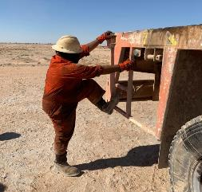
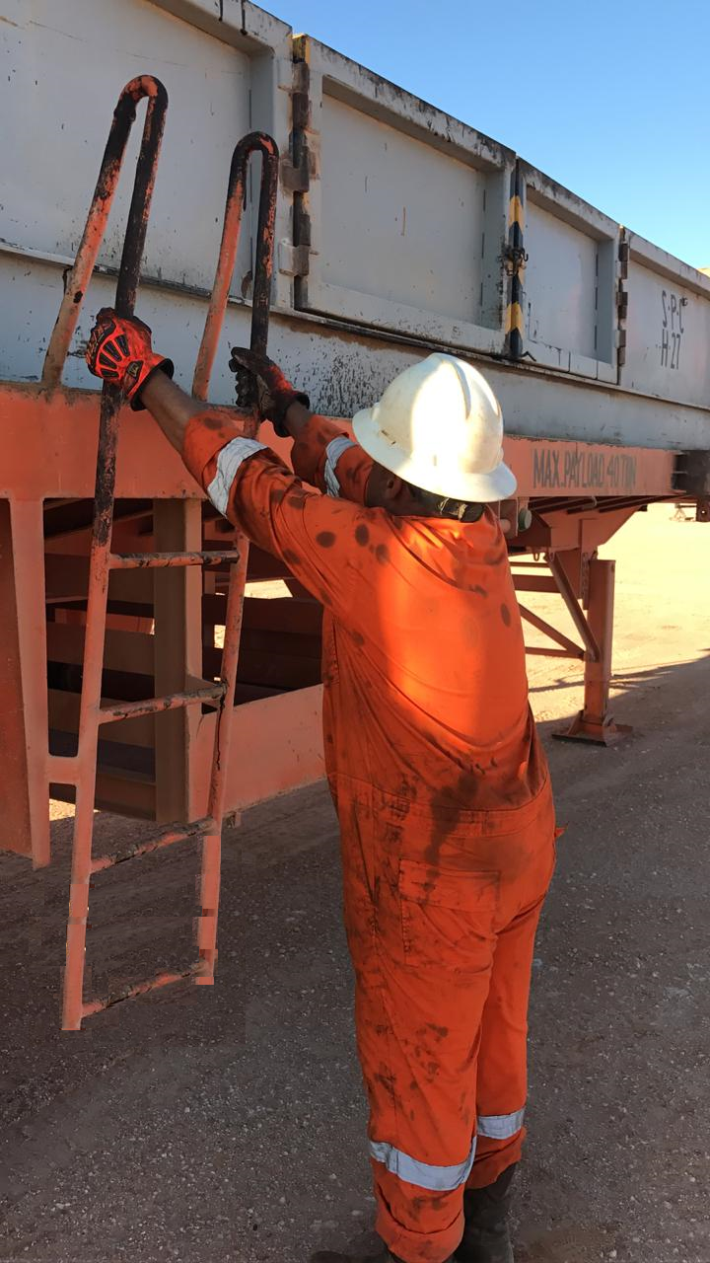
PDO Second Alert
Date: 12.11.2018 Incident type: LTI
What happened?
After loading the anchor block onto the Oilfield trailer, the Derrickman climbed the ladder onto the Oilfield Trailer. On this second step, he slipped and got his right leg caught in between the ladder. He was stuck in the ladder with his right leg approximately one 1 meter above ground level. The Driller helped him off the ladder.
Your learning from this incident…
Always stay focused, even on routine tasks
Report unsafe equipment to your supervisor
If you cannot do it in a safe way, stop!
Ask for support from your supervisor to do the task safely
Always ensure 3 point contact while using steps and ladders

Slide 2
Management self audit
Date: 12.11.2018 Incident type: LTI
As a learning from this incident and to ensure continual improvement, all Contract Managers must review their HSE HEMP against the questions asked below
Confirm the following:
Do you ensure access points to equipment are regularly inspected?
Are fixed installed handrails, guard rails, ladders, access points part of the Inspection program?
Do you review vehicles for access points (e.g. ladders, steps) as part of the maintenance plan?
Do you ensure all staff are trained on the 3-point-contact rule while climbing stairs and ladders?
Do you ensure that your learning from incident process captures the “Management Self Audit” questions from the Second Alerts?
Do you ensure that all relevant staff shave received the shared Learning from Incidents? (e.g. Drivers get relevant learnings, Derrickman get relevant learnings?)
Notes:
Make a list of closed questions (only ‘yes’ or ‘no’ as an answer) to ask other contractors if they have the same issues based on the management or HSE-MS failings or shortfalls identified in the investigation. Pretend you have to audit other companies to see if they could have the same issues.

