Slide 1
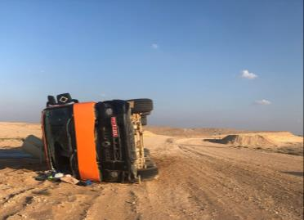
PDO Second Alert
Date: 27.11.218 Incident title: LTI
What happened?
ATE transit mixer loaded with 10 cubic meters of concrete after taking a left hand turn on the pipeline service graded road tipped over to right side. The helper (passenger) sustained fracture on his right wrist and the driver sustained first aid injuries.
Your learning from this incident.
Always keep wheels steady to recover from a drop wheel
Always drive on designated route - blacktop wherever available
Always use individual IVMS keys.
Always manage your journeys.
Always plan the activities.
SHORTCUT ROAD DRIVING IS DANGEROUS

Slide 2
Management self audit
Date: 27.11.218 Incident title: LTI
As a learning from this incident and to ensure continual improvement all contract managers must review their HSE HEMP against the questions asked below
Confirm the following:
Do your engineers plan all your activities to ensure employees are not put to haste?
Do your journey manager check the movement of vehicles and audit with the journey route adopted by drivers?
Do your journey manager ensure IVMS key management?
Do your journey manager/ IVMS coordinator intervene the drivers using private road?
Do your engineers ensure management of change?
Notes:
Make a list of closed questions (only ‘yes’ or ‘no’ as an answer) to ask other contractors if they have the same issues based on the management or HSE-MS failings or shortfalls identified in the investigation. Pretend you have to audit other companies to see if they could have the same issues.

