Slide 1
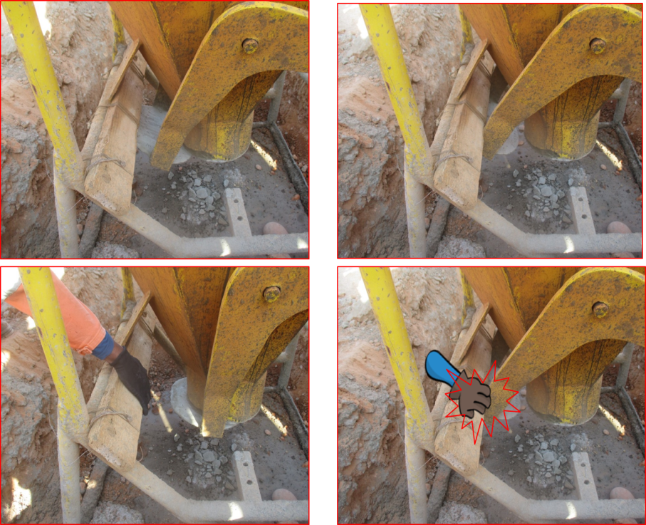
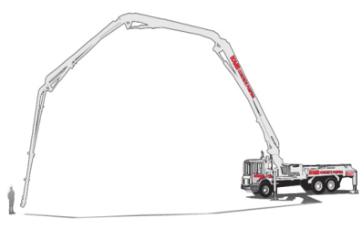
PDO Second Alert
Date: 27.11.2018 Incident title: LTI
What happened?
A Civil crew was involved in concreting activity using concrete pouring bucket. Three personnel were involved in handling the bucket. Two personnel were deployed in guiding the bucket and the other one was operating the handle of discharge door. While opening the discharge door one of the employee placed his right middle finger at the pinch point of the moving arm and the support frame and got injured.
Your learning from this incident.
Always plan activities to minimise manual handling.
Always identify pinch points and provide controls.
Always use equipment which is authorized by PTW
Maintain communication between peers
Notes:
Ensure all dates and titles are input
A short description should be provided without mentioning names of contractors or individuals. You should include, what happened, to who (by job title) and what injuries this resulted in. Nothing more!
Four to five bullet points highlighting the main findings from the investigation. Remember the target audience is the front line staff so this should be written in simple terms in a way that everyone can understand.
The strap line should be the main point you want to get across
The images should be self explanatory, what went wrong (if you create a reconstruction please ensure you do not put people at risk) and below how it should be done.

Slide 2
Management self audit
Date: 27.11.2018 Incident title: LTI
As a learning from this incident and to ensure continual improvement all contract managers must review their HSE HEMP against the questions asked below
Confirm the following:
Do you ensure the personnel are aware about pinch points?
Do you have system to conduct audits of Permit to Work ?
Do you ensure that HEMP is reviewed periodically?
Do you ensure adequacy of training for safe handling of equipment?
Do you ensure safe operating procedures are established?
Do you ensure individual assigned are adequately trained ?
Notes:
Ensure all dates and titles are input
Make a list of closed questions (only ‘yes’ or ‘no’ as an answer) to ask others if they have the same issues based on the management or HSE-MS failings or shortfalls identified in the investigation.
Imagine you have to audit other companies to see if they could have the same issues.
These questions should start with: Do you ensure…………………?

