Slide 1
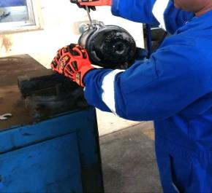
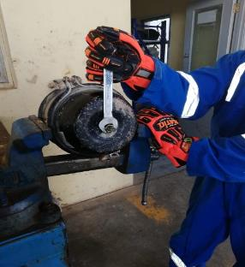
PDO Second Alert
Date: 14.12.2018 Incident title: Brake Booster LTI
What happened?
The mechanical technician was replacing a new double braking booster on a front axle of a pumping trailer as it did not fit (the clamps touching each other) therefore, the mechanic loosened the clamp without engaging the release tool (safety pin) which was securing the compressed spring chamber. Consequently, the compressed spring was released and the chamber cap hit the mechanic in his right eyelid.
Your learning from this incident..
Always refer to the Original Equipment Manufacturer instructions when installing the brake booster.
Only competent staff should undertake critical task.
Always STOP unsafe work.
Always avoid taking shortcut
Stay away from line of fire
Notes:
Ensure all dates and titles are input
A short description should be provided without mentioning names of contractors or individuals. You should include, what happened, to who (by job title) and what injuries this resulted in. Nothing more!
Four to five bullet points highlighting the main findings from the investigation. Remember the target audience is the front line staff so this should be written in simple terms in a way that everyone can understand.
The strap line should be the main point you want to get across
The images should be self explanatory, what went wrong (if you create a reconstruction please ensure you do not put people at risk) and below how it should be done.

Slide 2
Management self audit
Date: 14/12/2018 Incident title: Brake Booster LTI
As a learning from this incident and ensure continual improvement all contract
managers must review their HSE HEMP against the questions asked below
Confirm the following:
Do you ensure Original Equipment Manufacturer (OEM) instructions are part of your Maintenance procedure?
Do you ensure adequate supervision is part of the day-to-day job of supervisory staff?
Do you ensure that maintenance activities are captured in HEMP?
Do you ensure that you supervisors are competent to do the job?
* If the answer is NO to any of the above questions please ensure you take action to correct this finding.
Notes:
Ensure all dates and titles are input
Make a list of closed questions (only ‘yes’ or ‘no’ as an answer) to ask others if they have the same issues based on the management or HSE-MS failings or shortfalls identified in the investigation.
Imagine you have to audit other companies to see if they could have the same issues.
These questions should start with: Do you ensure…………………?

