Slide 1
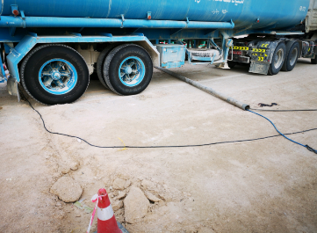
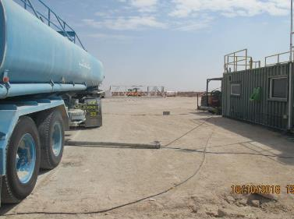
PDO Second Alert
Date: 17th October 2018 Incident title: LTI #25
What happened?
On 17th October 2018 at approximately 0915 Hrs a water tanker was proceeding to the water delivery point to deliver water. Upon arriving to location, as there was no access control, the driver drove through location and stopped at the office. The driver’s helper went to office to check where to offload the water. After the helper received instructions and was between the office and the truck, the driver began to move the truck. When the trailer wheels rolled over the cable protector pipe that has become dislodged, it struck the helper on the leg.
Your learning from this incident..
Ensure you will assess your work environment for moving hazards.
Understand that objects could move when driving over them.
Be always alert, do not put yourself in “ Line Of Fire”
Stop if in doubt or incase unsafe condition appears.
Stay in the view of Driver (Avoid Blind-spot)
Always assess your position and be away from “Line Of Fire”
Notes:
Ensure all dates and titles are input
A short description should be provided without mentioning names of contractors or individuals. You should include, what happened, to who (by job title) and what injuries this resulted in. Nothing more!
Four to five bullet points highlighting the main findings from the investigation. Remember the target audience is the front line staff so this should be written in simple terms in a way that everyone can understand.
The strap line should be the main point you want to get across
The images should be self explanatory, what went wrong (if you create a reconstruction please ensure you do not put people at risk) and below how it should be done.

Slide 2
Management self audit
Date: 17th October 2018 Incident title: LTI #25
As a learning from this incident and ensure continual improvement all contract
managers must review their HSE HEMP against the questions asked below
Confirm the following:
Do you ensure that worksite inspection is properly carried out?
Do you ensure that 3rd party personnel have the proper supervision needed to work on your location?
Do you ensure the competency framework includes hazard identification and risk assessment.
Do you control ingress & egress to your location?
* If the answer is NO to any of the above questions please ensure you take action to correct this finding.
Notes:
Ensure all dates and titles are input
Make a list of closed questions (only ‘yes’ or ‘no’ as an answer) to ask others if they have the same issues based on the management or HSE-MS failings or shortfalls identified in the investigation.
Imagine you have to audit other companies to see if they could have the same issues.
These questions should start with: Do you ensure…………………?

