Slide 1
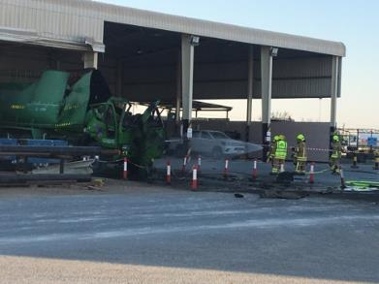





PDO Second Alert
Date: 29.12.2018 Incident: Property Damage
What happened?
On the 29th December 2018 at around 14:35 a water well injection company requested support from a welding workshop (through site in charge) in a welding repair to a tanker. The tanker arrived at the workshop at 15:45 where welder, began the welding repair of the rear outlet valve. During this activity the unknown substances inside the tanker ignited, resulting in an explosion ripping through the front portion of the tank and drivers cab as well as the workshop roof.
As the blast wave went forward there were no injuries to staff with only the tanker and workshop roof being damaged.
The PDO emergency CCR was activated by the site manager.
Your learning from this incident.
Always perform a gas test when working with tanks or confined space type jobs
Always use the right tools and or vessels for the job
Always do a risk assessment before starting a new type of job
Always have appropriate ventilation system when welding
Always make sure to check content before welding
ALL tanks should be treated as if they contained explosive gas or liquid materials.
Risk assess, confined space access and gas testing to be completed prior to tanker welding activities
Gas test before welding

Slide 2
Management self audit
Date: 29.12.2018 Incident: Property Damage
As a learning from this incident and to ensure continual improvement all contract managers must review their HSE HEMP against the questions asked below
Confirm the following:
Do you ensure that you follow procedure before performing a new task?
Do you ensure Gas testing is done before performing confined space activity?
Do you ensure this job is part of the companies contract?
Do you ensure that you are following the correct approved standards when performing jobs?
Do you ensure that you are using the right tool of equipment for the job?
Do you ensure that you have all controls in place before commencing any activity?
Do you ensure that tank repairs are not carried out without HSE and Engineering involvement.

