Slide 1
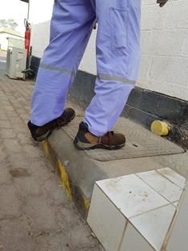
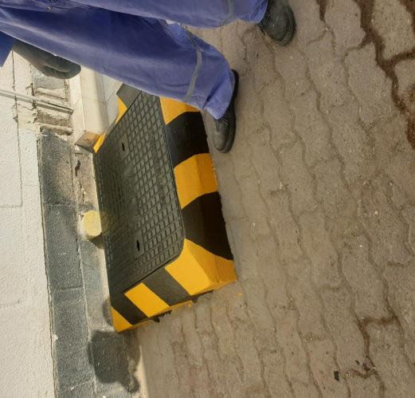
PDO Second Alert
Date: 16/12/18: Incident: LTI
What happened?
After completing his work the electrician collected his tools from the step ladder tool tray that was located on top of a manhole slab. On collection of his tools his simultaneously stepped backwards off the manhole slab, his foot catching the angled side of the manhole slab causing him to lose balance and fall to the ground, his left hand impacting the ground causing a fracture to his wrist.
Your learning from this incident..
Always pay attention to your footing and take note of your Spatial awareness when working on uneven surfaces
Always identify Hazards even on routine tasks prior to starting work,
Always ensure that safe access and egress to assets is available before Installation of any new equipment
Always engage with local Safety Advisors prior to the maintenance of any asset with restricted access and egress to ensure risk is as low as reasonably practicable
Always ensure that work is correctly planned before commencement of the job
Notes:
Ensure all dates and titles are input
A short description should be provided without mentioning names of contractors or individuals. You should include, what happened, to who (by job title) and what injuries this resulted in. Nothing more!
Four to five bullet points highlighting the main findings from the investigation. Remember the target audience is the front line staff so this should be written in simple terms in a way that everyone can understand.
The strap line should be the main point you want to get across
The images should be self explanatory, what went wrong (if you create a reconstruction please ensure you do not put people at risk) and below how it should be done.

Slide 2
Management self audit
Date: 16/12/18: Incident: LTI
As a learning from this incident and to ensure continual improvement all contract
managers must review their HSE HEMP against the questions asked below
Confirm the following:
Do you ensure that your employees identify all hazards have been identified before work commences and reduce risk ALARP?
Do you ensure that assets are easily assessable for maintenance by your employees or subcontractors?
Do you ensure that your employees correctly planned work before before work commences?
Do you ensure that the working are layout is safe before commencing work?
Do you ensure that audits identify all hazards in the work place ?
* If the answer is NO to any of the above questions please ensure you take action to correct this finding.
Notes:
Ensure all dates and titles are input
Make a list of closed questions (only ‘yes’ or ‘no’ as an answer) to ask others if they have the same issues based on the management or HSE-MS failings or shortfalls identified in the investigation.
Imagine you have to audit other companies to see if they could have the same issues.
These questions should start with: Do you ensure…………………?

