Slide 1
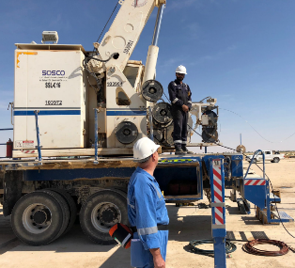
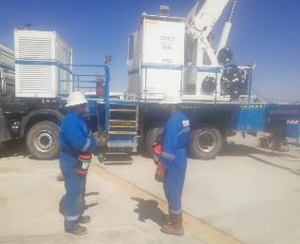
PDO Second Alert
Date: 18/12/2018 Incident title Fall from Height
What happened?
The tool specialist was on the slickline unit deck adjacent to the outrigger and speaking to the PDO site supervisor. Suddenly, the tool specialist fell from the slickline unit deck to ground (concrete pad) injuring his wrist and chin and became unconscious.
Your learning from this incident..
Always make sure you that you are physically fit to perform your task.
Always stop work if you feel that you or your coworkers are tired.
Always make sure that are you protected while working at height.
Ensure that you are working in an authorised equipment and position.
If you feel you are unfit for work, STOP.
Notes:
Ensure all dates and titles are input
A short description should be provided without mentioning names of contractors or individuals. You should include, what happened, to who (by job title) and what injuries this resulted in. Nothing more!
Four to five bullet points highlighting the main findings from the investigation. Remember the target audience is the front line staff so this should be written in simple terms in a way that everyone can understand.
The strap line should be the main point you want to get across
The images should be self explanatory, what went wrong (if you create a reconstruction please ensure you do not put people at risk) and below how it should be done.

Slide 2
Management self audit
Date: 18/12/2018 Incident title Fall from Height LTI
As a learning from this incident and ensure continual improvement all contract
managers must review their HSE HEMP against the questions asked below
Confirm the following:
Do you ensure that you personnel are fit for work before they go to worksite?
Do you ensure that your personnel are protected from falling from height?
Do you ensure that you personnel are empowered to stop work in case they see either unsafe acts or unsafe conditions
Do you make sure that contractors /third party who are involved in your operations are safely managed?
* If the answer is NO to any of the above questions please ensure you take action to correct this finding.
Notes:
Ensure all dates and titles are input
Make a list of closed questions (only ‘yes’ or ‘no’ as an answer) to ask others if they have the same issues based on the management or HSE-MS failings or shortfalls identified in the investigation.
Imagine you have to audit other companies to see if they could have the same issues.
These questions should start with: Do you ensure…………………?

