Slide 1
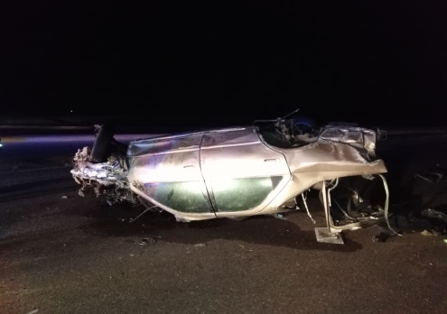
PDO Second Alert
Date: 20/03/19 Incident title: Commuting fatality
What happened?
On 20/3/2019 a derrick man attended duty at 18:00, at around 20:05 he asked Night Tool Pusher to go to rest and was dropped by a colleague to his private vehicle at around 20:25.The derrick man drove his private vehicle approaching Wadi Al Ain roundabout and rolled over. In rolling over, he was ejected from the car. He was declared dead on the scene by the ROP and medical team that had arrived at approx. 21:15
Your learning from this incident..
Always use commuting buses for travelling from home to work
Always wear seatbelt and keep to the speed limits for the road conditions
Ensure you inform your supervisor if you have an emergency and only use company provided arrangements for emergency travel even at night
Always use the commuting facilities provided

Slide 2
Management self audit
Date: 20/03/2019 Incident title: Commuting Fatality
As a learning from this incident and to ensure continual improvement all contract managers must review their HSE HEMP against the questions asked below
Confirm the following:
Do you ensure effectiveness of your commuting procedure?
Do you ensure site management are compliant to procedure and they are reporting to senior management any non compliance?
Do you ensure site leadership are effectively managing employees?
Do you ensure that your staff are facing no difficulties in travelling to/from work (Hubs, bus timings)?
Do you ensure audits are conducted to verify compliance to Commuting procedure?
* If the answer is NO to any of the above questions please ensure you take action to correct this finding.

