Slide 1
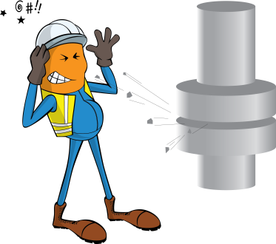
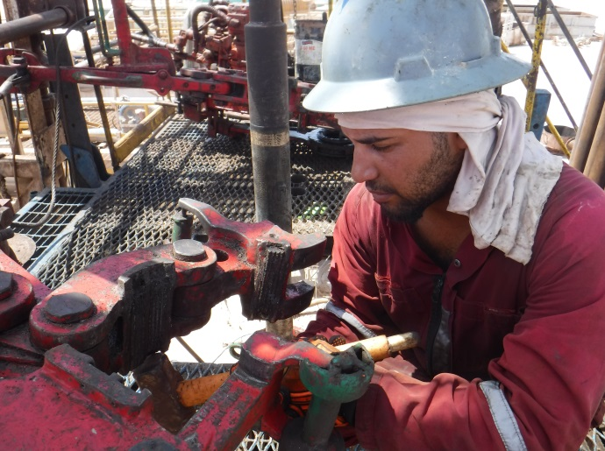
PDO Incident First Alert
Incident type | LTI (#05a)
Date/ time | 21.05.2019 at 21:30 hrs. | Directorate
Location | Yibal | Dept
What happened
While the Roustabout was hammering to remove the dies from the manual tong small piece of metal ejected and hit his upper right eye resulting an injury.
Mr. Musleh asks the questions of can it happen to you?
Are you aware of all hazards that are identified of the task you performing?
Do you use the right tools for the job?
Do you use proper PPE for the task?
Please disseminate this LTI notification to your teams and use it in your tool box talks and HSE meetings and notice boards.

