Slide 1
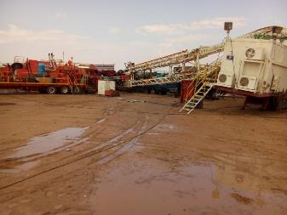
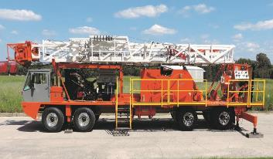
PDO Second Alert
Date: 13th April, 2019 Incident title: Property Damage
What happened?
While Running in hole 3-1/2 EUE singles from cat walk - at 1871m
(1992 TD), the weather changed and it started to rain followed by
rapidly increasing severe winds. The crew followed the well
securing procedures and started securing the well. After installing
FOSV the weather had become too severe to safely continue and
the NTP moved the crew to tea room. The storm worsened
within 5 mins, this resulted in bringing the Hoist Mast down on to
the Rig Manager Caravan, which also contains the tea room. All
personnel reported, no injuries
Your learning from this incident..
Review the anchoring procedure to take into account the adverse weather condition including flooding and muddy location condition.
Implement adverse weather alert system and clear actions to be taken in the field.
Use a tensioner device to ensure the anchors guy lines are properly tensioned.
Ensure ERP covers adverse weather condition and controls to be implemented and drilled.
Flooding can change all the equations including anchoring.
Consider hoists with self anchoring system.
Flooding can change effectiveness of anchoring.
Notes:
Ensure all dates and titles are input
A short description should be provided without mentioning names of contractors or individuals. You should include, what happened, to who (by job title) and what injuries this resulted in. Nothing more!
Four to five bullet points highlighting the main findings from the investigation. Remember the target audience is the front line staff so this should be written in simple terms in a way that everyone can understand.
The strap line should be the main point you want to get across
The images should be self explanatory, what went wrong (if you create a reconstruction please ensure you do not put people at risk) and below how it should be done.

Slide 2
Management self audit
Date: 13th April 2019 Incident title : Property (Hoist) damage Incident
As a learning from this incident and ensure continual improvement all contract
managers must review their HSE HEMP against the questions asked below
Confirm the following:
Do you ensure that OEM guidelines for anchoring the hoist / rig are clear ?
Do you ensure that anchoring SOP is inline with OEM requirements?
Do you ensure to burry the anchor blocks for better stability and for effectively holding the Mast in adverse weather condition such as strong winds / heavy rainfall?
Do you verify that HEMP covers HSE controls to be applied in case of adverse weather condition / storm / flooding?
Do you ensure that your rig / hoist layout clearly shows that your site based office / tea room caravans should not be within Mast drop down zone? How do you verify its consistent implementation.
Read the guidance notes please
* If the answer is NO to any of the above questions please ensure you take action to correct this finding.
Notes:
Ensure all dates and titles are input
Make a list of closed questions (only ‘yes’ or ‘no’ as an answer) to ask others if they have the same issues based on the management or HSE-MS failings or shortfalls identified in the investigation.
Imagine you have to audit other companies to see if they could have the same issues.
These questions should start with: Do you ensure…………………?

