Slide 1
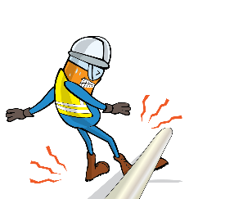
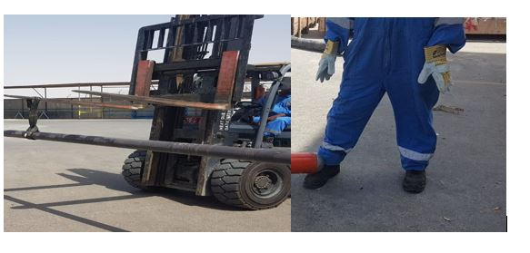


PDO Incident First Alert - PDO
Incident type | LTI (#06)
Date/ time | 27.06.2019 at 08:45 hrs. | Directorate
Location | Fahud | Dept
What happened
While moving a 13m pipe through a workshop gate, one end of the pipe hit an existing stand moving the load on the sling causing the pipe to drop on to the left foot of the technician assisting the movement.
Mr. Musleh asks the questions of can it happen to you?
Do you ensure you are stood in a safe place?
Do you ensure you identify all hazards before starting a task?
Do you use the correct rigging method to do the job?
Do you consider if you are in the ‘line of fire’?
Please disseminate this LTI notification to your teams and use it in your tool box talks and HSE meetings and notice boards.

