Slide 1
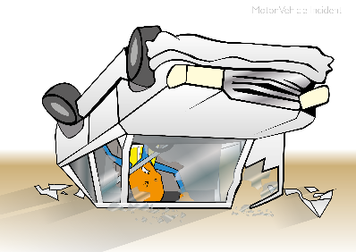
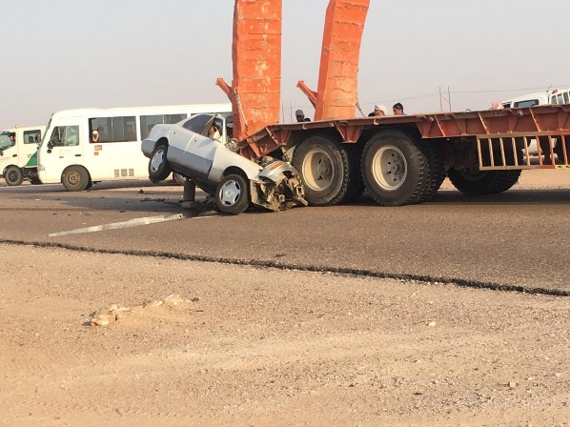


PDO Incident Road Safety Alert – (Private vehicles)
Incident type | Non-Work Related Commuting (#02)
Date/ time | 01/07/2019 @17:25Hrs
Location | Qarn Alam - Saih Rawl Area
What happened
A contractor employee was returning to work from his rest days using his private vehicle. After passing Qarn Alam roundabout towards Saih Rawl he crashed into the rear of a low bed trailer.
Sadly, he passed away as a result of the incident. Our thoughts and prayers are with the family of the deceased.
Mr. Musleh asks the questions of can it happen to you?
Do you risk commuting by private vehicle?
Do you always focus on the road ahead while driving?
Do you continue driving if you are fatigued?
Do you always obey the speed limits?
Please disseminate this notification to your teams and use it in your tool box talks, HSE meetings and notice boards.

