Slide 1
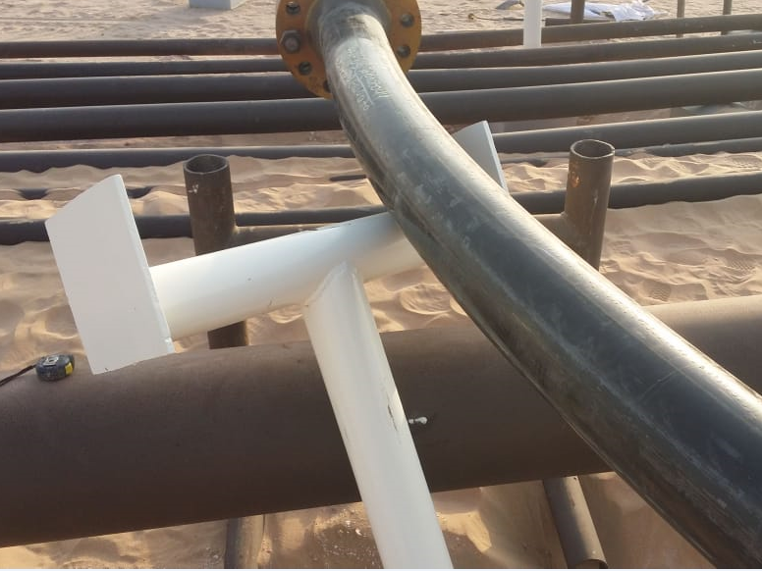
PDO Incident First Alert
Incident type | LTI (#07)
Date/ time | 07.07.2019 at 15:30 hrs. | Directorate
Location | Bahja | Dept
What happened
While inserting a pipe support under a newly installed pipeline, the support slipped crushing the Mason’s left hand index and middle fingers between the support and the pipe.
Mr. Musleh asks the questions of can it happen to you?
Do you ensure you keep your hands and fingers away from pinch points?
Do you ensure you identify all hazards before starting a task?
Do you consider if you are in the ‘line of fire’?
crush point
Please disseminate this LTI notification to your teams and use it in your tool box talks, HSE meetings and notice boards.

