Slide 1
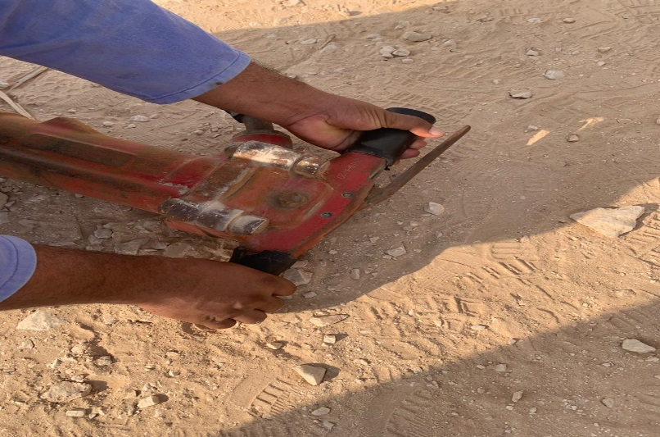
PDO Incident First Alert
Incident type | LTI (#08)
Date/ time | 09.07.2019 at 12:40 hrs. | Directorate
Location | Nimr | Dept
What happened
While lowering the jackhammer to the ground from his shoulder, the handle of the jackhammer crushed the helper’s left hand causing multiple fractures.
Mr. Musleh asks the questions of can it happen to you?
Do you always follow the correct manual handling procedure
Do you ensure you keep your hands and fingers away from pinch points?
Do you ensure you identify all hazards before starting a task?
Do you consider if you are in the ‘line of fire’?
crush point
Please disseminate this LTI notification to your teams and use it in your tool box talks and HSE meetings and notice boards.

