Slide 1
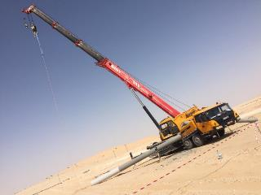

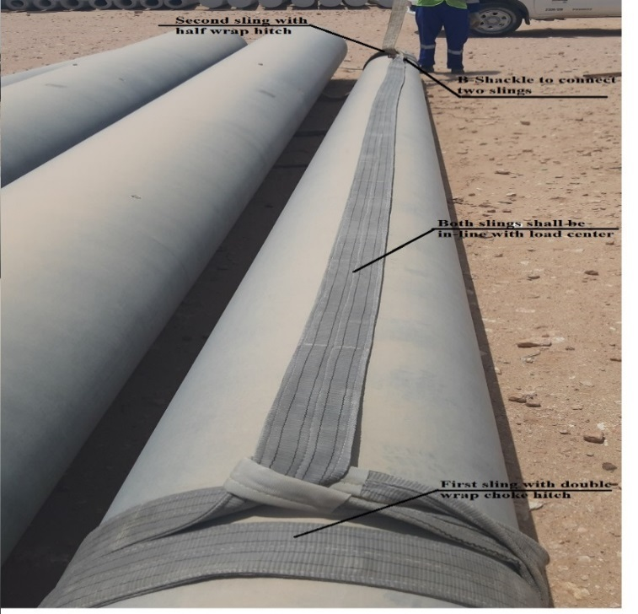
PDO Second Alert
Date: 24.04.2019 Incident title: Hipo# 31, OHL lifting Incident
What happened?
An electrical crew was engaged in guard pole erection at Hawqa 23 road crossing location. The crane operator raised the pole into the vertical position. While attempting to lift the guard pole, the round endless sling failed to grip the pole and the sling slipped off. The concrete pole toppled onto the crane at the rear side of the driver cabin.
Your learning from this incident:
Always ensure approved lifting plan is available before commencement of lifting activity.
Always ensure that correct rigging method is used for lifting.
Always ensure right equipment are in place before commencement of task.
Always ensure proper communication and coordination between Appointed Person, Permit Applicant and crew members.
Ensure correct rigging method and proper equipment used for lifting activity

Slide 2
Management self audit
Date: 24.04.2019 Incident title: Hipo# 31, OHL lifting Incident
As a learning from this incident and ensure continual improvement all contract
managers must review their HSE HEMP against the questions asked below.
Confirm the following:
Do you ensure that appropriate lifting plan is attached along with PTW?
Do you ensure the Rigging method used is correct as per procedure?
Do your supervisors visit site before applying the permit to see the site conditions?
Do your supervisors explain about PTW requirements with appropriate control measures to crew at site?
Do you ensure that sub-contractor management is appropriate at site?
* If the answer is NO to any of the above questions please ensure you take action to correct this finding.

