Slide 1
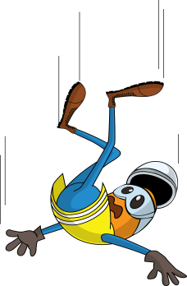
PDO Incident First Alert
Incident type | LTI (#09)
Date/ time | 11.07.2019 at 18:05 hrs. | Directorate
Location | Karim Small Fields | Dept
What happened
The Senior Field Operator(SFO) and crew were packing equipment in the rear of the wireline truck, as they were closing the roller cover the SFO lost his balance and fell to the ground fracturing his right arm.
Mr. Musleh asks the questions of can it happen to you?
Do you ensure you have safe access and egress?
Do you always pay attention to where you are stepping?
Do you always consider how you can fall from height?
Please disseminate this LTI notification to your teams and use it in your tool box talks and HSE meetings and notice boards.

