Slide 1
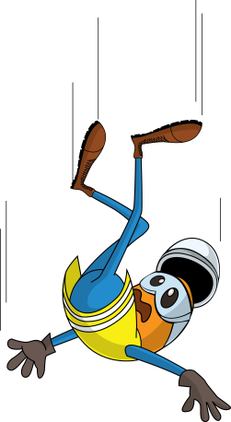
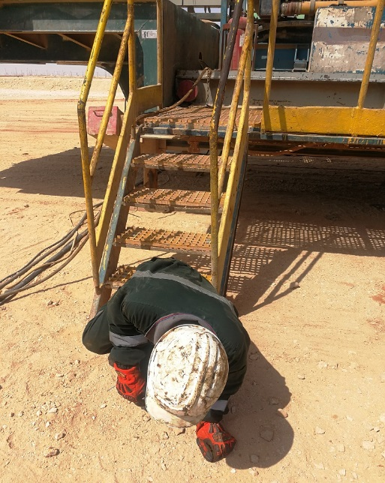
PDO Incident First Alert
Incident type | LTI (#12)
Date/ time | 28.08.19 @09:30hrs | Directorate
Location | Rima | Dept
What happened
While descending from the stairs the Roustabout lost his balance and fell resulting in a fracture to his left wrist.
Mr. Musleh asks the questions of can it happen to you?
Do you ensure you have safe access and egress?
Do you ensure you identify all hazards before starting a task?
Do you always ensure you keep 3 points of contact when climbing down?
Left arm wrist
Please disseminate this LTI notification to your teams and use it in your tool box talks and HSE meetings and notice boards.

