Slide 1
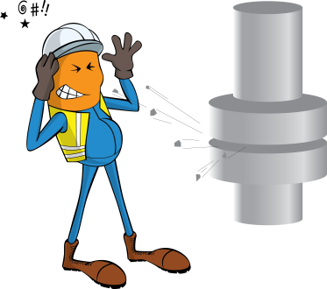
PDO Incident First Alert
Incident type | LTI (#13)
Date/ time | 19.07.19 @10:50hrs | Directorate
Location | Qarn Alam | Dept
What happened
The driver observed that the truck was not performing properly, he stopped the vehicle to check the condition of truck and trailer. Whilst doing a 360-degree check around the vehicle, the tire caught fire and burst ejecting debris causing injury to his eyes.
Mr. Musleh asks the questions of can it happen to you?
Do you ensure Heavy Vehicle brake air test is conducted prior to start a journey?
Do you report any issues with brakes immediately to maintenance?
Do you wear your safety glass while inspecting the vehicle?
Please disseminate this LTI notification to your teams and use it in your tool box talks and HSE meetings and notice boards.

