Slide 1
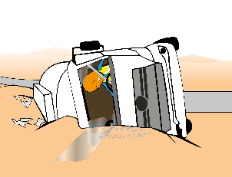
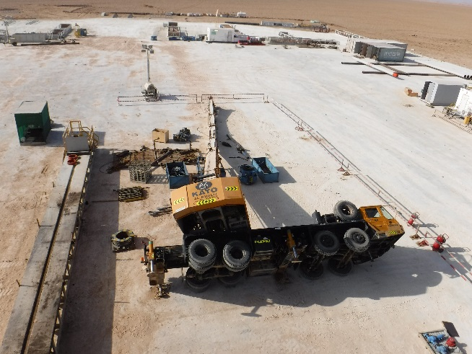
PDO Incident First Alert
Incident type | HiPo#54 Lifting Incident
Date/ time | 16.09.19@ 20:25hrs | Directorate
Location | Rig 75 | Dept
What happened
During preparation of rig up 18 5/8” Casing handling equipment, after offloading the Top Drive System (TDS) bails the crane slew to lift another load, before attaching the load the crane tipped over. There were no injuries in the incident.
Mr. Musleh asks the questions of can it happen to you?
Do you ensure you check and confirm all outriggers are out and extended before lifting ?
Do you ensure all lifting (routine/non routine) have an approved lift plan?
Do you ensure a Lifting Supervisor is supervising the lifting operation?
Do you ensure adequate risk assessment is carried out before the of start any lift?
Do you ensure the lifting area is barricaded during lifting operations?
Please disseminate this HiPo notification to your teams and use it in your tool box talks and HSE meetings and notice boards.

