Slide 1
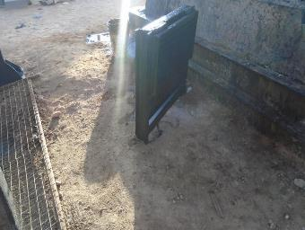
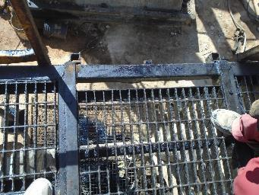
PDO Second Alert
Date: 21.01.19 Incident: HiPo#03
What happened?
While removing a stuffing box using hydraulic winch, the winch chain contacted a removable rig floor insert (slide in type) and pushed it from its original position causing it to fall between the beam pump concrete block and the roustabout who was standing beneath, and was pulling the line in order to lay the stuffing box on the ground. The roustabout sustained minor scratches on the left shoulder as the grating fell.
Your learning from this incident..
Always identify potential hazards and implement control measures before starting work
Always identify potential for dropped object and conduct inspection to ensure adequate retention methods
Always ensure adequate supervision
Always comply with SOP and use approved safe work methods
Always stay away from the line of fire
Always ensure there is no line entangled during the lifting
The landing position of the insert
Always inspect work area for potential of dropped object and adequate retention methods
The removable piece with inserted pins
Notes:
Ensure all dates and titles are input
A short description should be provided without mentioning names of contractors or individuals. You should include, what happened, to who (by job title) and what injuries this resulted in. Nothing more!
Four to five bullet points highlighting the main findings from the investigation. Remember the target audience is the front line staff so this should be written in simple terms in a way that everyone can understand.
The strap line should be the main point you want to get across
The images should be self explanatory, what went wrong (if you create a reconstruction please ensure you do not put people at risk) and below how it should be done.

Slide 2
Management self audit
Date: 21.01.19 Incident: HiPo#03 dropped object
As a learning from this incident and ensure continual improvement all contract
managers must review their HSE HEMP against the questions asked below
Confirm the following:
Do you ensure that all removable items are captured in the DROPS register?
Do you ensure that you check all removable items and verify that they are all secured with primary and secondary retention?
Do you ensure that all other potential dropped object which have not been captured in the register previously are identified and communicated to the crew?
Do you ensure that there might be similar type of removable inserts on other rigs/hoists and that the issue is adequately addressed to prevent dropped object?
Do you assure implementation of Permit to Work system?
Do you assure implementation of SOP’s?
Do you ensure that all employees are trained and competent in identifying potential for dropped object?
Do you ensure that employees are empowered to STOP unsafe job?
Do you ensure adequate supervision of critical tasks?
* If the answer is NO to any of the above questions please ensure you take action to correct this finding.
Notes:
Ensure all dates and titles are input
Make a list of closed questions (only ‘yes’ or ‘no’ as an answer) to ask others if they have the same issues based on the management or HSE-MS failings or shortfalls identified in the investigation.
Imagine you have to audit other companies to see if they could have the same issues.
These questions should start with: Do you ensure…………………?

