Slide 1
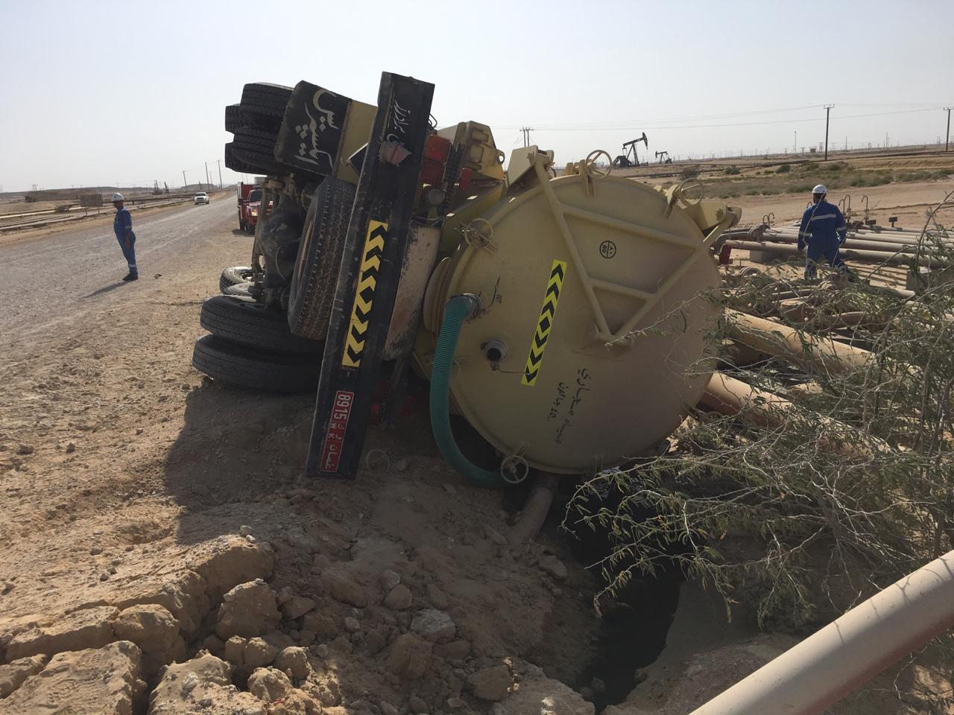
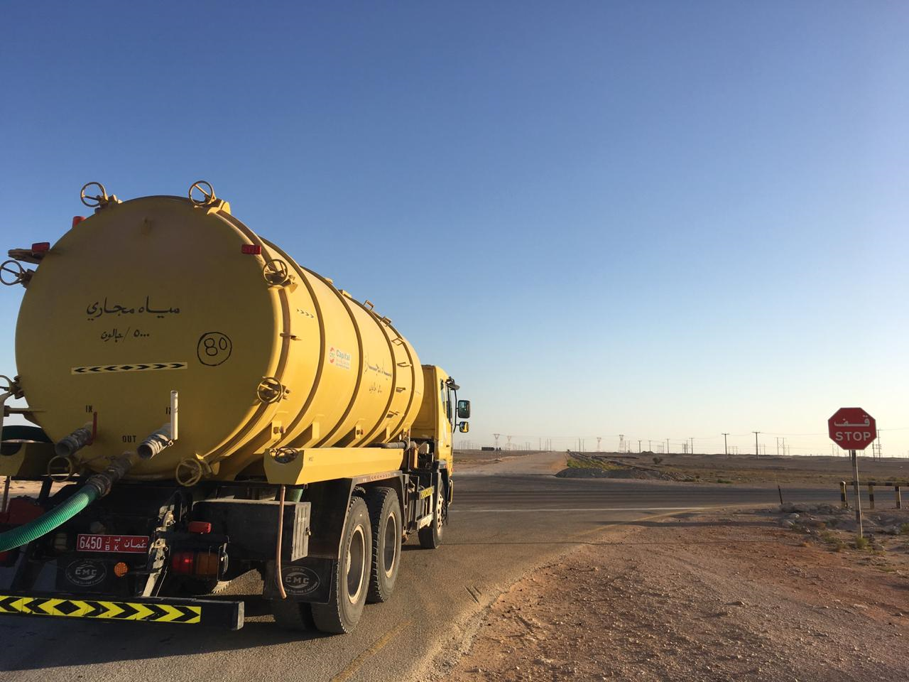
PDO Second Alert
Date: 04 February 2019 Incident title: MVI HiPo #04
What happened?
Whilst negotiating a left hand turn at a T-junction on a graded road, the tanker tipped over on to it’s passenger side. The tanker landed in a ditch at the side of the road landing on 2 x pipe lines. The Driver and Helper were able to exit the vehicle through the windscreen which had fell out during the incident. The Driver had not sustained any injuries, the Helper received bruising and pain to his right elbow and right little finger.
Your learning from this incident..
Always ensure you STOP at STOP signs
Always ensure you drive at a speed according to the road conditions
Always ensure you slow down for roundabouts, sharp bends, corners and junctions
Always ensure you follow your defensive driver training
Always ensure new drivers are on-boarded correctly and driver habits are assessed
Ensure you STOP at junctions where directed by road signs

Slide 2
Management self audit
Date: 04th February 2019 Incident title: MVI HiPo#04
As a learning from this incident and ensure continual improvement all contract
managers must review their HSE HEMP against the questions asked below
Confirm the following:
Do you ensure all employees receive incident learning briefs?
Do you ensure your drivers are regularly briefed on following Road Safety Rules?
Do you ensure new employees receive a robust HSDE induction including previous relevant incident learnings?
Do you ensure all new employees meet the minimum age requirements for their role?
Do you ensure all new drivers follow a robust on boarding and competency assessment process?
Do you ensure all staff receive the correct PDO approved Medical fitness to work certificate from the PDO approved clinic after they have conducted their medical
Do you conduct in depth analysis of IVMS monitoring / driver habits?
* If the answer is NO to any of the above questions please ensure you take action to correct this finding.
Notes:
Ensure all dates and titles are input
Make a list of closed questions (only ‘yes’ or ‘no’ as an answer) to ask others if they have the same issues based on the management or HSE-MS failings or shortfalls identified in the investigation.
Imagine you have to audit other companies to see if they could have the same issues.
These questions should start with: Do you ensure…………………?

