Slide 1
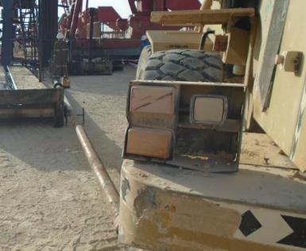
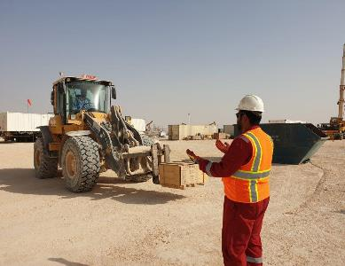
PDO Second Alert
Date: 03.02.2019 Incident: LTI struck by
What happened?
Derrickman planning to change the seals on the hanger assembly requested the forklift operator to lift one end of the assembly to put the seals through. After having it completed, the forklift operator started performing a reverse maneuver to leave the worksite area and while doing that he tapped the other side of the assembly with the forklift’s rear tire that resulted in one of the stands falling onto the ground together with the assembly and striking the employee on the right foot.
Your learning from this incident..
Always use approved and designed specs tools and equipment
Always identify hazards/risks of the task and implement control measures
Always ensure that the worksite is safe to operate
Always ensure that all concerned parties attend pre-job brief
Always ensure adequate supervision and spot checks during the task
Always use Take 5 before, during and after the task
Mobile equipment shall not move without adequate signals
Notes:
Ensure all dates and titles are input
A short description should be provided without mentioning names of contractors or individuals. You should include, what happened, to who (by job title) and what injuries this resulted in. Nothing more!
Four to five bullet points highlighting the main findings from the investigation. Remember the target audience is the front line staff so this should be written in simple terms in a way that everyone can understand.
The strap line should be the main point you want to get across
The images should be self explanatory, what went wrong (if you create a reconstruction please ensure you do not put people at risk) and below how it should be done.

Slide 2
Management self audit
Date: 03.02.2019 Incident: LTI struck by
As a learning from this incident and ensure continual improvement all contract
managers must review their HSE HEMP against the questions asked below
Confirm the following:
Do you ensure that all not to specs equipment are identified and destroyed?
Do you ensure that worksite design not to specs and home-made equipment and tools are identified and removed?
Do you ensure that all equipment is captured in PMS and properly certified?
Do you ensure that the assembly seals will not be changed on the ground in the future?
Do you assure implementation of Permit to Work system and risk management tools?
Do you assure implementation of frequent audits and worksite inspections?
Do you ensure that mobile equipment operators (forklift and crane) are adequately trained, assessed and competent?
Do you ensure that employees are aware of the line of fire hazards?
Do you ensure the quality of pre-job safety briefs?
Do you assure that MOC is used when conditions are changed?
* If the answer is NO to any of the above questions please ensure you take action to correct this finding.
Notes:
Ensure all dates and titles are input
Make a list of closed questions (only ‘yes’ or ‘no’ as an answer) to ask others if they have the same issues based on the management or HSE-MS failings or shortfalls identified in the investigation.
Imagine you have to audit other companies to see if they could have the same issues.
These questions should start with: Do you ensure…………………?

