Slide 1
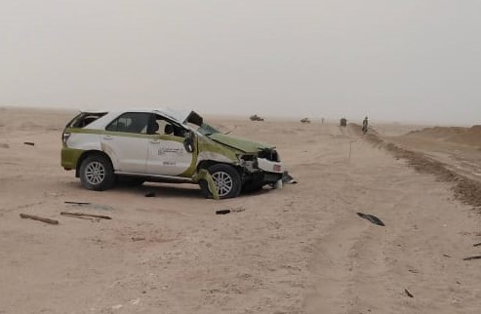
PDO Second Alert
Date: 24th March 2019 Incident title: MVI LTI
What happened?
While driving on a slight uphill on the graded road, the driver came across sand pile on the top of the uphill. As he swerve to the left to avoid hitting the sand pile, he lost control of the vehicle and rollover. The driver sustained back injury and injuries to the fingers and both feet.
Your learning from this incident..
Always follow the speed limit for the road.
Always adjust your speed to the condition of the road.
Always drive defensively.
Always observe and follow the road signage.
Slow down and always drive to the conditions of the road.
Notes:
Ensure all dates and titles are input
A short description should be provided without mentioning names of contractors or individuals. You should include, what happened, to who (by job title) and what injuries this resulted in. Nothing more!
Four to five bullet points highlighting the main findings from the investigation. Remember the target audience is the front line staff so this should be written in simple terms in a way that everyone can understand.
The strap line should be the main point you want to get across
The images should be self explanatory, what went wrong (if you create a reconstruction please ensure you do not put people at risk) and below how it should be done.

Slide 2
Management self audit
Date: 24th March 2019 Incident title: MVI LTI
As a learning from this incident and ensure continual improvement all contract
managers must review their HSE HEMP against the questions asked below
Confirm the following:
Are all your drivers fully aware of the defensive driving techniques and use them at all times?
Are all your drivers always follow and comply with the Journey Management Plan?
Are all your drivers aware of the emergency response and actions in case of a road accident?
Is your safe journey management in compliance with SP 2000 requirement?
Do you conduct self verification audit for the Safe Journey Management?
Do you ensure that all vehicles in use meeting the SP 2000 requirement?
* If the answer is NO to any of the above questions please ensure you take action to correct this finding.
Notes:
Ensure all dates and titles are input
Make a list of closed questions (only ‘yes’ or ‘no’ as an answer) to ask others if they have the same issues based on the management or HSE-MS failings or shortfalls identified in the investigation.
Imagine you have to audit other companies to see if they could have the same issues.
These questions should start with: Do you ensure…………………?

