Slide 1
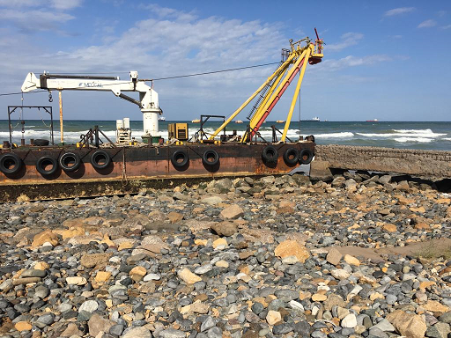
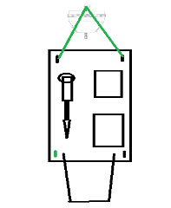
PDO Second Alert
Date: 06/02/2019 Incident title: Barge incident
What happened?
During some rough weather one of the two mooring lines holding the maintenance barge to the mooring buoy failed. An assessment by the marine maintenance team resulted in a decision to use a small boat to secure a towing line to the barge. While preparations were underway it was noticed that the barge and the mooring buoy were drifting towards the MAF beach.
Your learning from this incident..
Always not to over reliance on the weather report.
Obtain MOC and complete RA before and any step out taken place even for written off equipment
Barge in the beach
Always risk assess asset disposal
Securing arrangement
Notes:
Ensure all dates and titles are input
A short description should be provided without mentioning names of contractors or individuals. You should include, what happened, to who (by job title) and what injuries this resulted in. Nothing more!
Four to five bullet points highlighting the main findings from the investigation. Remember the target audience is the front line staff so this should be written in simple terms in a way that everyone can understand.
The strap line should be the main point you want to get across
The images should be self explanatory, what went wrong (if you create a reconstruction please ensure you do not put people at risk) and below how it should be done.

Slide 2
Management self audit
Date: 06/02/2019 Incident title: Barge incident
As a learning from this incident and ensure continual improvement all contract
managers must review their HSE HEMP against the questions asked below
Confirm the following:
Do you ensure learning from incident captured all potential failure and rectify them?
Do you ensure all marine craft are properly secured in rough weather?
Do you ensure marine offshore assets and equipment inspected as per plans?
Do you ensure MOC and RA available before any step out?
Do you ensure written-off marine vessel are moved to safe location?
Do you ensure written-off and disposal process simple and timely?
* If the answer is NO to any of the above questions please ensure you take action to correct this finding.
Notes:
Ensure all dates and titles are input
Make a list of closed questions (only ‘yes’ or ‘no’ as an answer) to ask others if they have the same issues based on the management or HSE-MS failings or shortfalls identified in the investigation.
Imagine you have to audit other companies to see if they could have the same issues.
These questions should start with: Do you ensure…………………?

