Slide 1
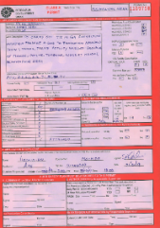
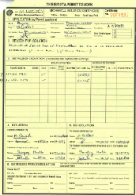
PDO Second Alert
Date: 04 Feb 19 Incident title : HIPO # 07
What happened?
Mechanical crew attempted to brake flange of a 2” injection manifold which was connected to 20” sour liquid line without valid PTW and isolation certificate and without donning BA sets While opening the bolt crew smelt H2S gas and stopped the activity
Your learning from this incident..
Always confirm lines are positively isolated
Always ensure permit available for the activity
Always remember that you are authorized to stop unsafe activity
Always consider a process line to be ‘live’ unless proven otherwise
Only open lines with the use of the proper PPE, in this case with BA sets donned.
Not authorized
Lifesaving rules are made to save lives, follow it
Fully authorized
Notes:
Ensure all dates and titles are input
A short description should be provided without mentioning names of contractors or individuals. You should include, what happened, to who (by job title) and what injuries this resulted in. Nothing more!
Four to five bullet points highlighting the main findings from the investigation. Remember the target audience is the front line staff so this should be written in simple terms in a way that everyone can understand.
The strap line should be the main point you want to get across
The images should be self explanatory, what went wrong (if you create a reconstruction please ensure you do not put people at risk) and below how it should be done.

Slide 2
Management self audit
Date: 04 Feb 19 Incident title : HIPO # 07
As a learning from this incident and ensure continual improvement all contract
managers must review their HSE HEMP against the questions asked below
Confirm the following:
Do you ensure before commencement of activities approved PTW in place?
Do you ensure Isolation certificates obtained while working on live line ?
Have you ensure adequate communication between supervisors and work force during planning of work as well as before commencement of task ?
Do you ensure the flange breaking activity done with BA sets ?
Do you ensure whether your team has adequate process safety awareness while working in HMEPs area?
If the answer is NO to any of the above questions please ensure you take action to correct this finding.
Notes:
Ensure all dates and titles are input
Make a list of closed questions (only ‘yes’ or ‘no’ as an answer) to ask others if they have the same issues based on the management or HSE-MS failings or shortfalls identified in the investigation.
Imagine you have to audit other companies to see if they could have the same issues.
These questions should start with: Do you ensure…………………?

