Slide 1
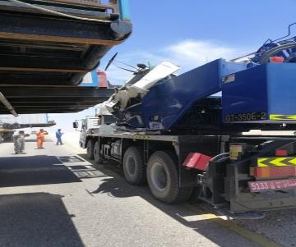
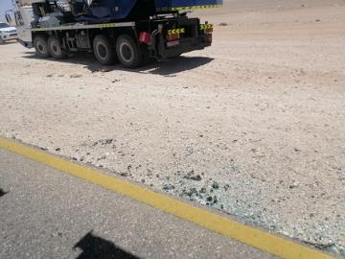
PDO Second Alert
Date: 10.04.19 Incident : HiPo#24 Hoist move MVI
What happened?
A loaded rig vehicle slightly collided with a 35 ton TANADO
crane on Thayfut – Rima black top road. When seeing the rig
movement , the crane parked on the road side. The loaded
truck while passing the crane hit with the crane operator cabin
and the body got damaged. No injury
Your learning from this incident:
Do not use the road during rig movement.
Always stop rig movement during unexpected obstruction on the road.
Always follow defensive driving
Vehicle shall be moved out of the road during rig movement
Notes:
Ensure all dates and titles are input
A short description should be provided without mentioning names of contractors or individuals. You should include, what happened, to who (by job title) and what injuries this resulted in. Nothing more!
Four to five bullet points highlighting the main findings from the investigation. Remember the target audience is the front line staff so this should be written in simple terms in a way that everyone can understand.
The strap line should be the main point you want to get across
The images should be self explanatory, what went wrong (if you create a reconstruction please ensure you do not put people at risk) and below how it should be done.

Slide 2
Management self audit
Date: 10.04.19 Incident : HiPo#24 Hoist move MVI
As a learning from this incident and ensure continual improvement all contract
managers must review their HSE HEMP against the questions asked below
Confirm the following:
Do you ensure all drivers are aware of what is to be done when there is Rig movement on the road?
Do you ensure all operators are aware of what actions to be taken when there is any restriction in movement?
Do you ensure staff are aware always to keep clear during any Rig/Hoist move?
Do you ensure all rigs/Hoist are moved in compliance to SP1512?
* If the answer is NO to any of the above questions please ensure you take action to correct this finding.
Notes:
Ensure all dates and titles are input
Make a list of closed questions (only ‘yes’ or ‘no’ as an answer) to ask others if they have the same issues based on the management or HSE-MS failings or shortfalls identified in the investigation.
Imagine you have to audit other companies to see if they could have the same issues.
These questions should start with: Do you ensure…………………?

