Slide 1
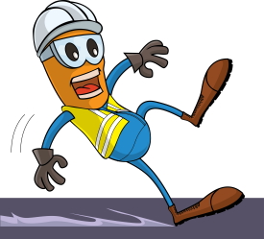
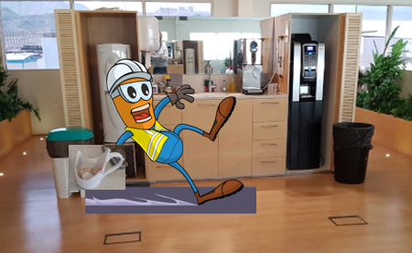
PDO Incident First Alert
Incident type | LTI (#14)
Date/ time | 30.09.19 @10:00hrs | Directorate
Location | Min Al Fahal | Dept
What happened
The pipeline engineer lost balance while holding a coffee cup that broke as he fell, resulting in multiple cuts to his hand. He was treated immediately by a first aider on scene and transferred Khoula hospital.
Mr. Musleh asks the questions of can it happen to you?
Do you ensure you identify all slip, trip, fall points in the work place?
Do you ensure you are wearing the correct type of foot wear?
Do you ensure you are standing in the right position to do the task?
Please disseminate this LTI notification to your teams and use it in your tool box talks and HSE meetings and notice boards.

